Slide 1
The Schrödinger Equation
Wei-Li Chen
12/07/2015

Slide 2
Wave Equation
A particle has the wave property such as interference and diffraction. Its wavelength is the de Broglie wavelength. But what is its exact description of wave property, the wave function?
The Schrödinger equation is the wave equation which governs the propagation of matter waves.
Maxwell equation ➔ EM wave
Schrödinger equation ➔ matter wave

Slide 3
Traveling waves

Slide 5
The Schrödinger Equation

Slide 6
Time Independent Schrödinger Equation

Slide 7
Born’s Interpretation
Ψ (complex) is the particle wave description of the electron. The
quantity |Ψ|²=Ψ*Ψ (real) is proportional to the probability of detecting
an electron in a unit volume.
In one dimension, |Ψ|²dx is the probability of an electron being in the
interval dx.
P(x)dx = |Ψ|²dx
where P(x) is the probability distribution function.

Slide 8
Expectation Values and Operators

Slide 9
Operators

Slide 10
Solving Schrödinger Equation
The fundamental problem of quantum mechanics is to solve the Schrödinger equation for the wave function. The measurable quantities such as position, momentum, energy…etc can be calculated using appropriate operators.
The Schrödinger equation is a linear differential equation. The superposition of solutions is still the solution to it.
The required boundary conditions comes from Born’s interpretation of wave function and associated physical explanation.

Slide 11
Boundary Conditions

Slide 12
Boundary Conditions

Slide 13
Linear Differential Equation
The Schrödinger Equation is a linear differential equation. Its solutions are called eigenfunctions. The linear combination of eigenfunctions are also solutions to it.
Two waves are superimposed by adding them up. Don’t add up |Ψ|². (double slit interference experiment)

Slide 14
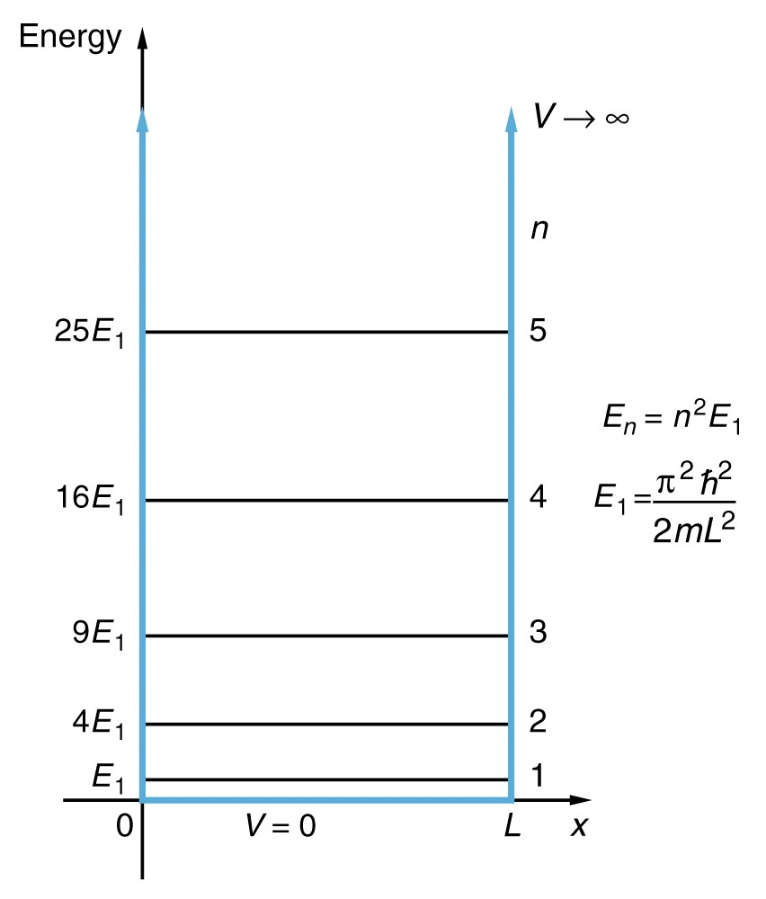
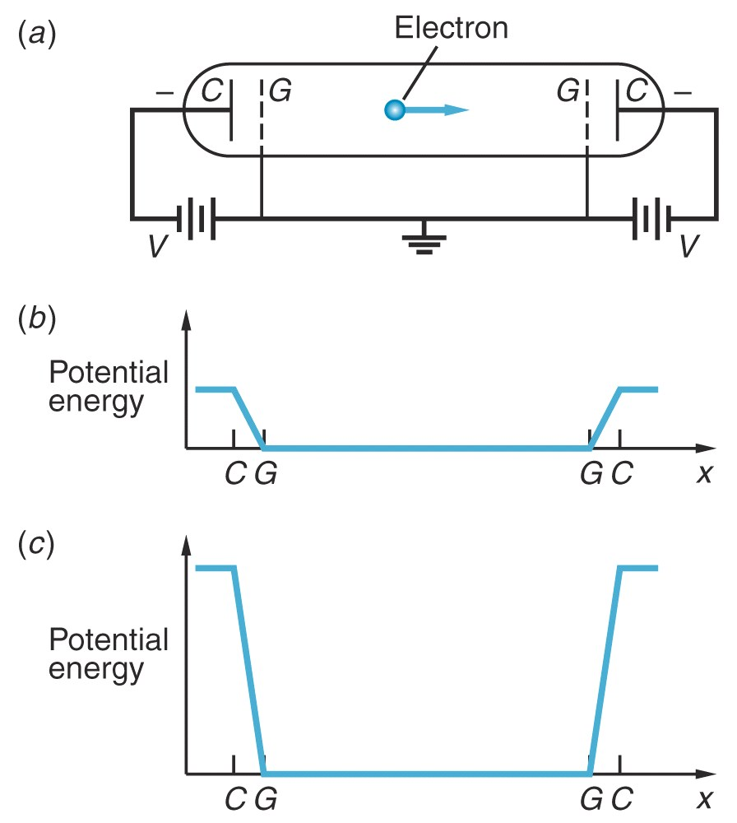
The Infinite Square Well

Slide 15
Apply Standing Wave Condition

Slide 17
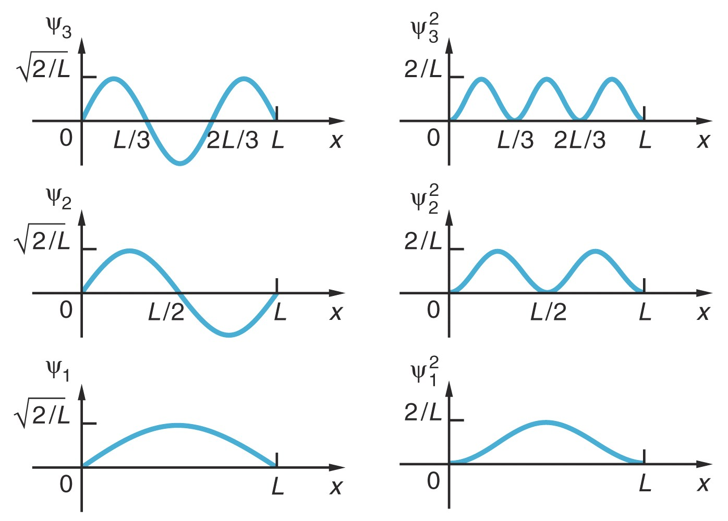
n=3
n=2
n=1

Slide 18
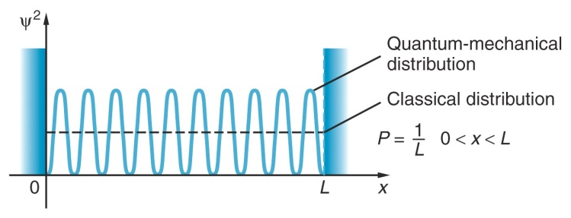
Comparison with classical results
The complete wave function

Slide 19
The Finite Square Well
If E>V₀, E can be any value.
The situation will be just like a free electron.
If 0<E<V₀, we need to solve the Schrödinger Equation:
Quantum wells are heterojunction structures that forms
the finite square well.
I II III

Slide 20
We solve the Schrodinger equation in 3 zones separately.
Then the full solution to it is:

Slide 21
Because the potential energy is an even function, there is no reason that a particle will prefer to occur on one side against the other. Therefore
The solutions to the Schrodinger equation here are either even or odd functions.
even
Now we will calculate the even and odd function solutions separately.

Slide 24
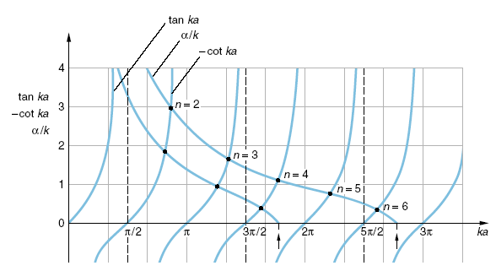
As the well gets deeper and wider
➔it can accommodate more modes
For different V₀ value the x-intersection will be different.

Slide 25
Using ka as x-axis

Slide 26
Using E as x-axis

Slide 27
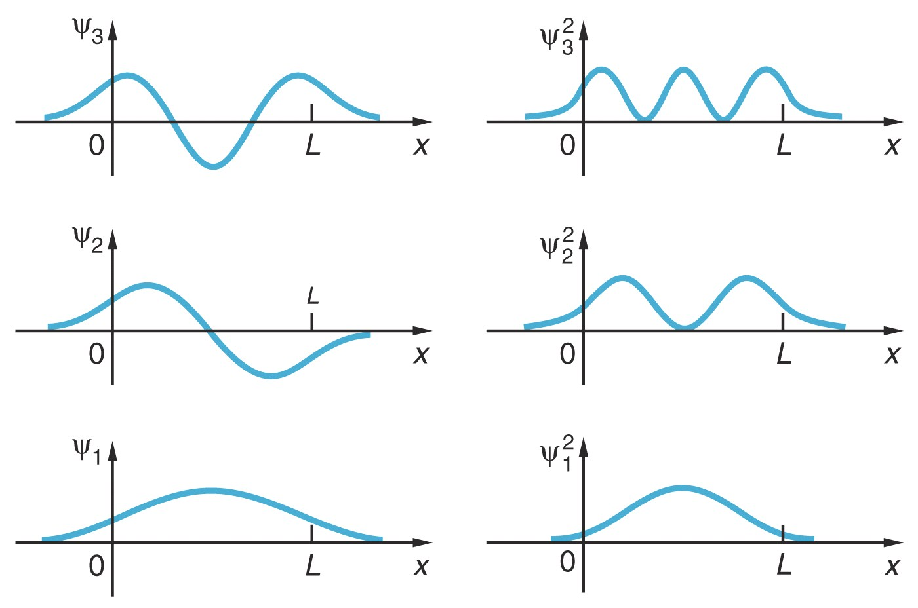

Slide 28
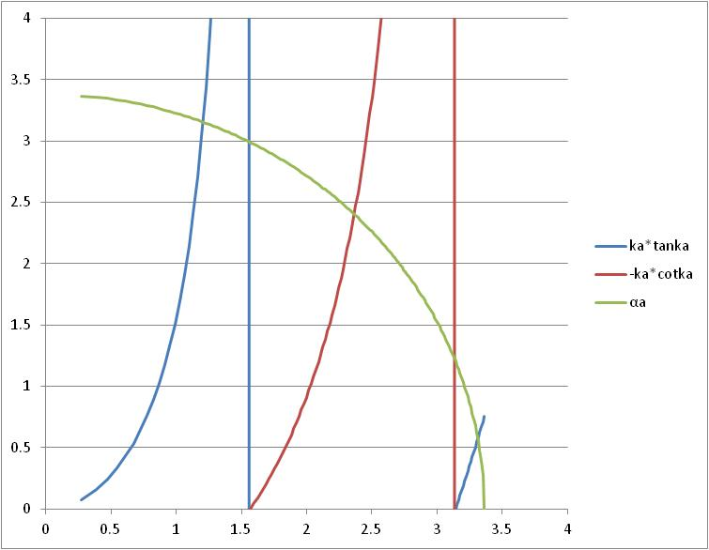
Alternative graphic solution

Slide 30
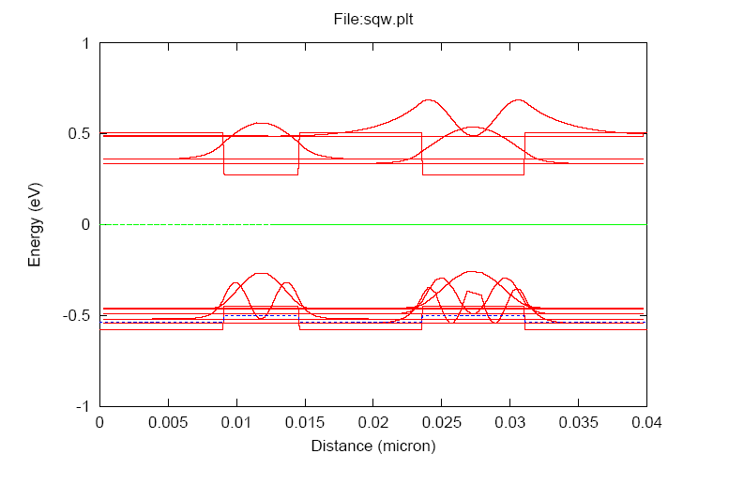

Slide 31
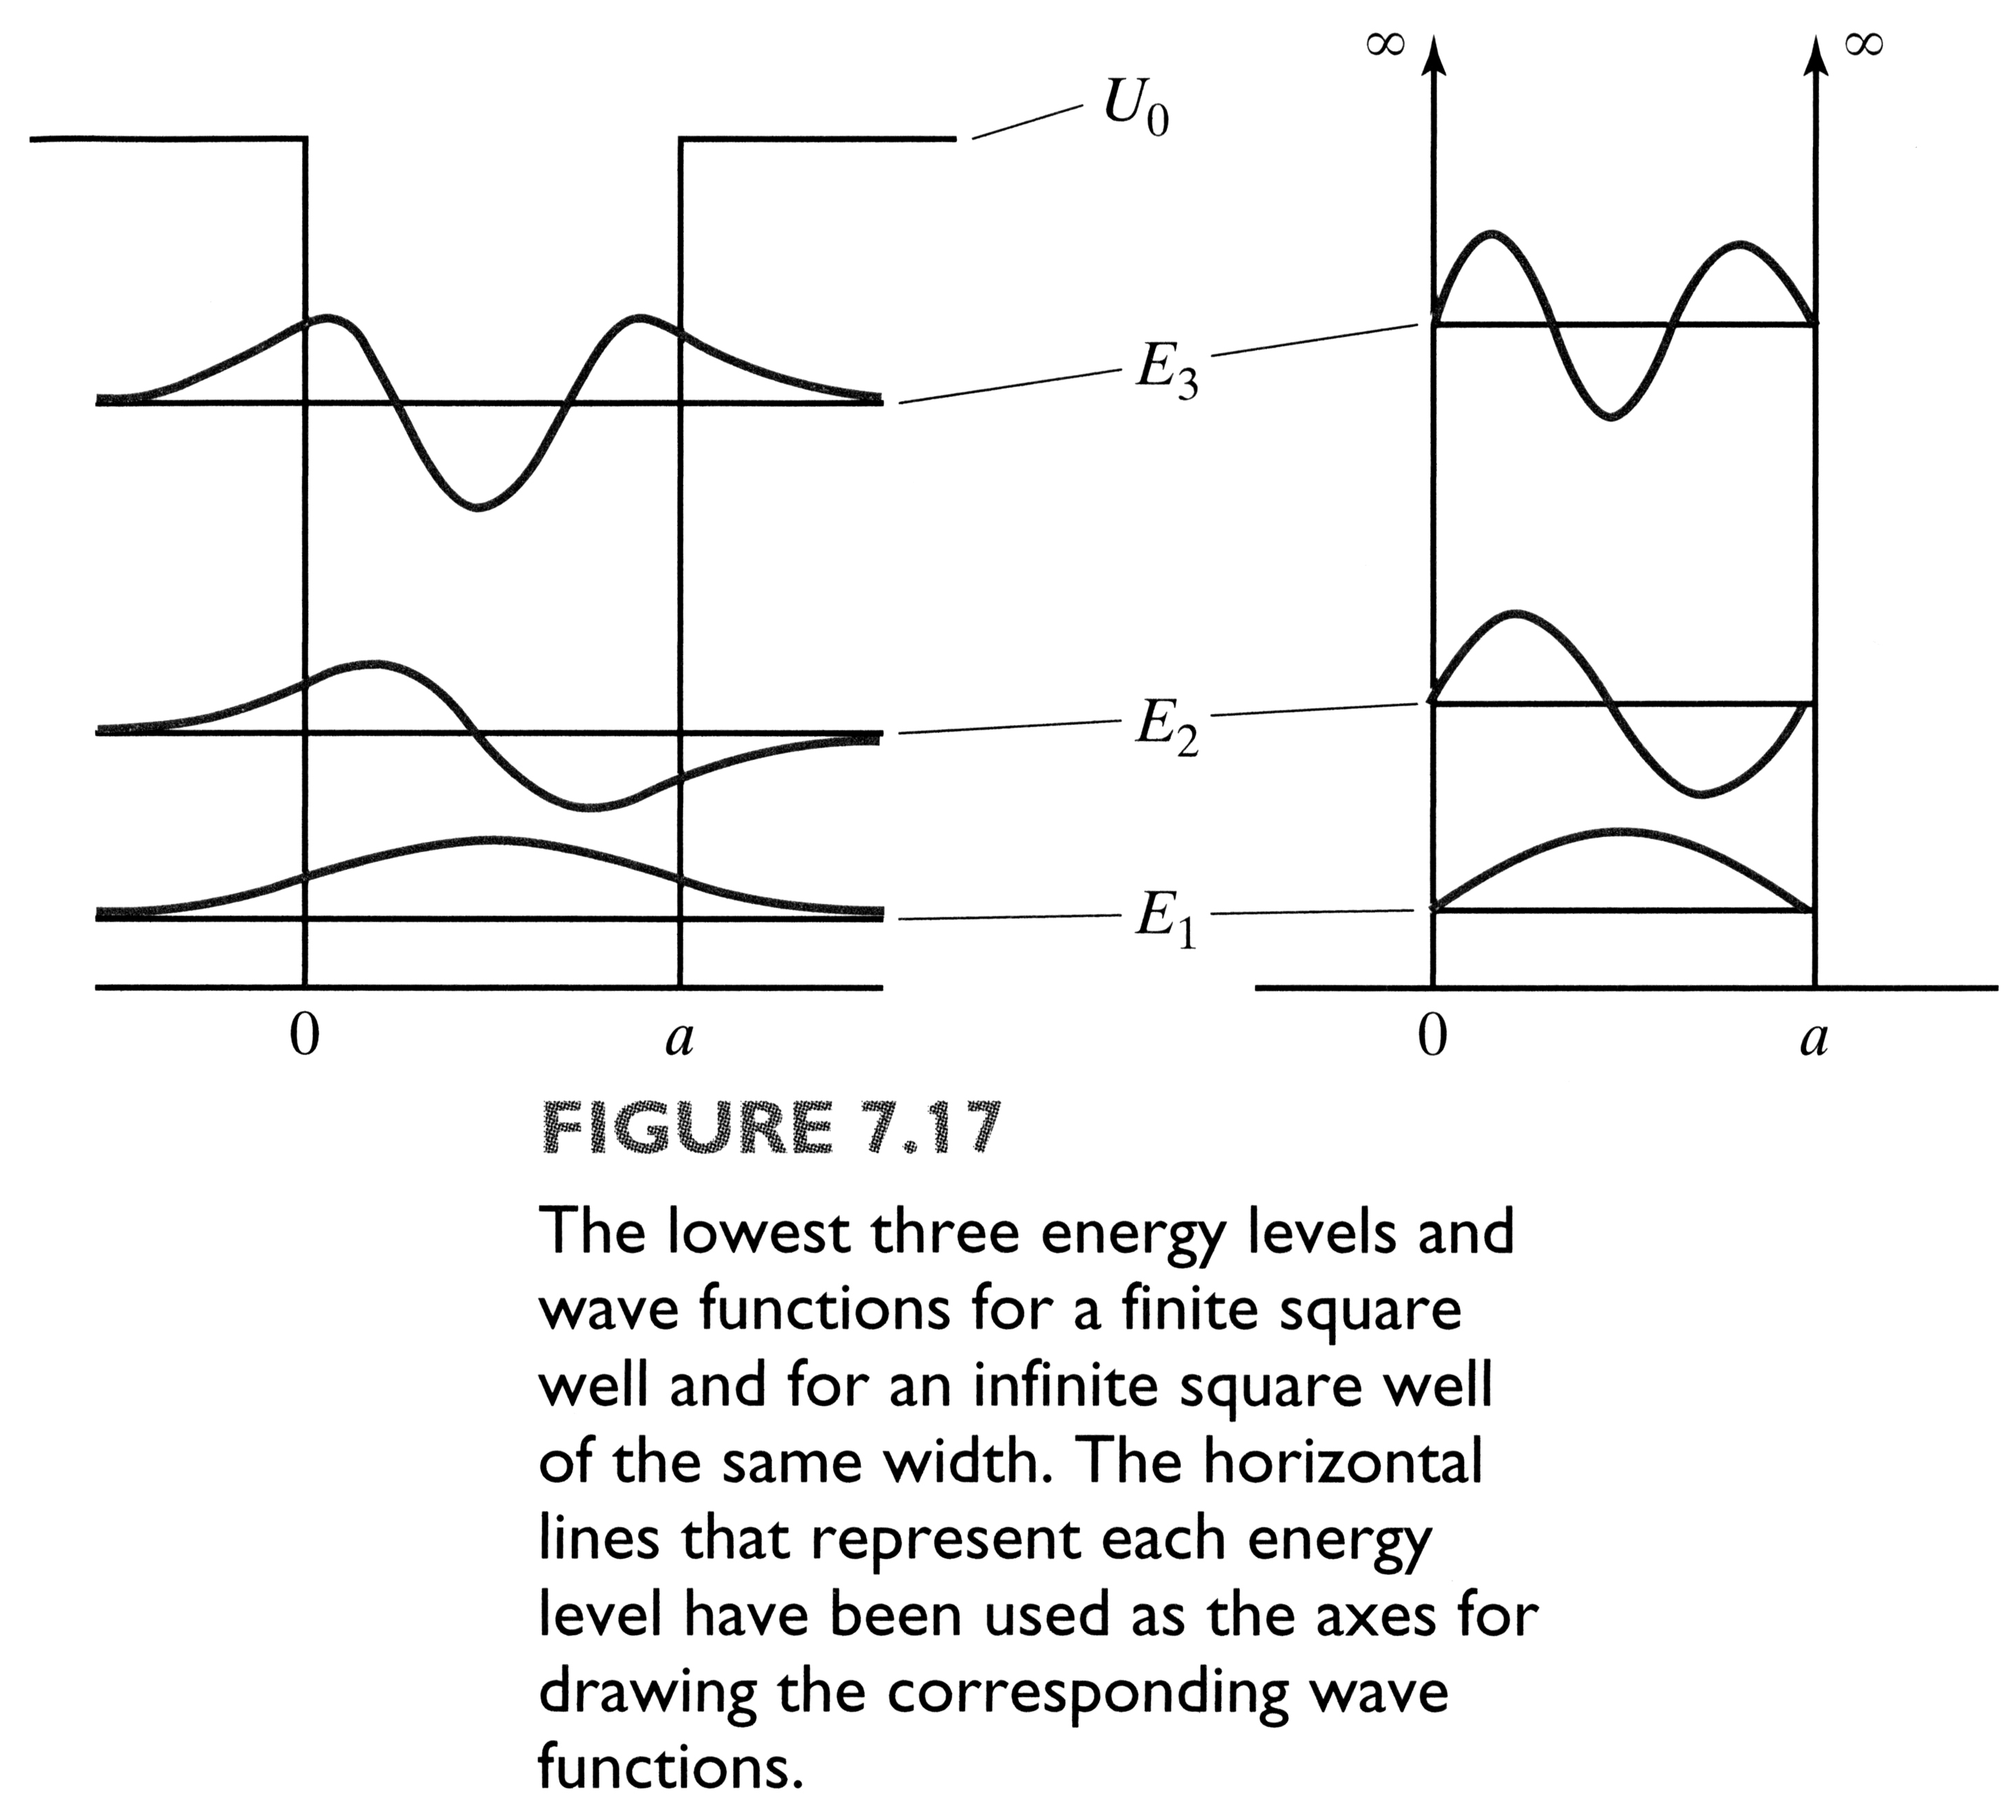

Slide 32
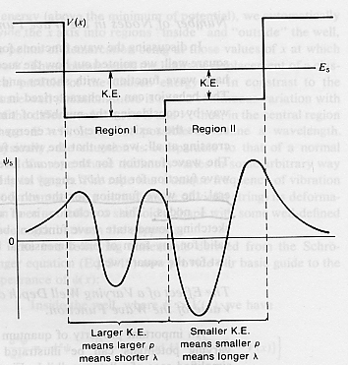
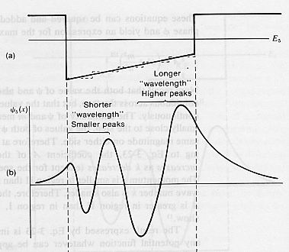

Slide 33
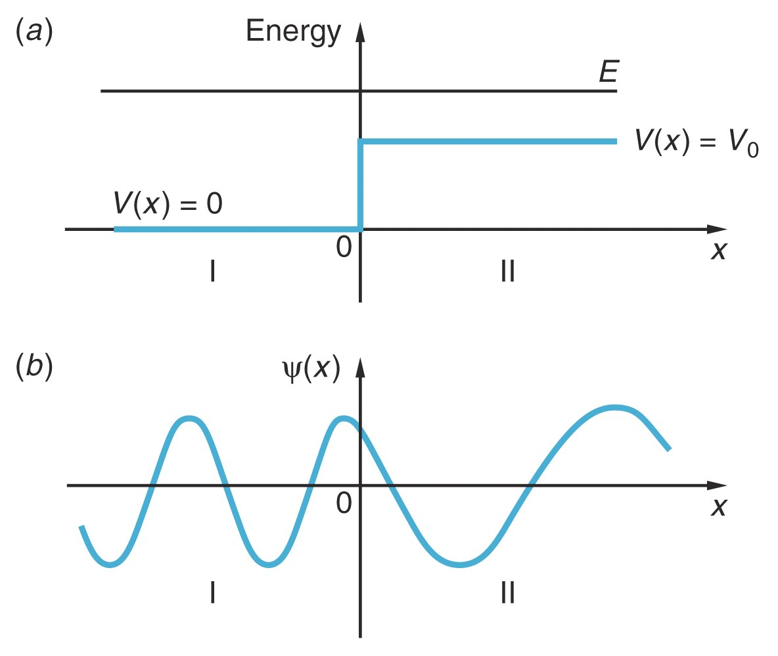
Free Particales

Slide 35
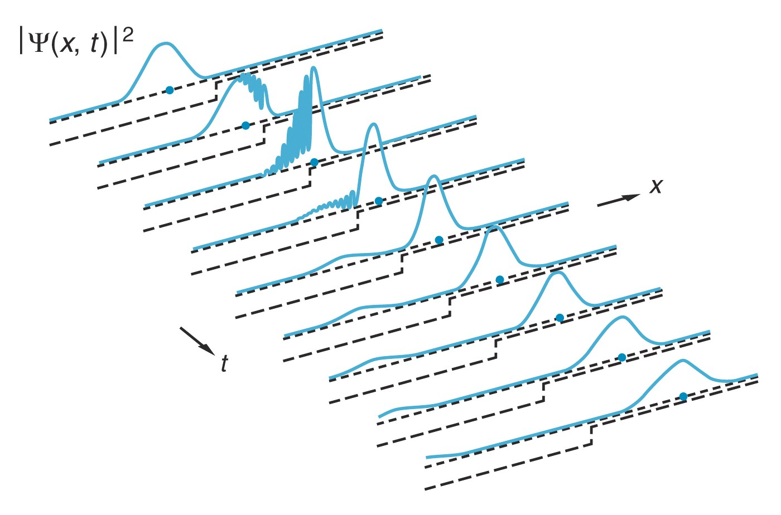
Reflection and Transmission of Waves
A wave pocket comprises of many harmonic waves，and these waves interference while overlapping with each other.

Slide 37
It is analogous to the total internal reflection in optics
The penetration part is analogous to the evanescent field.

Slide 38
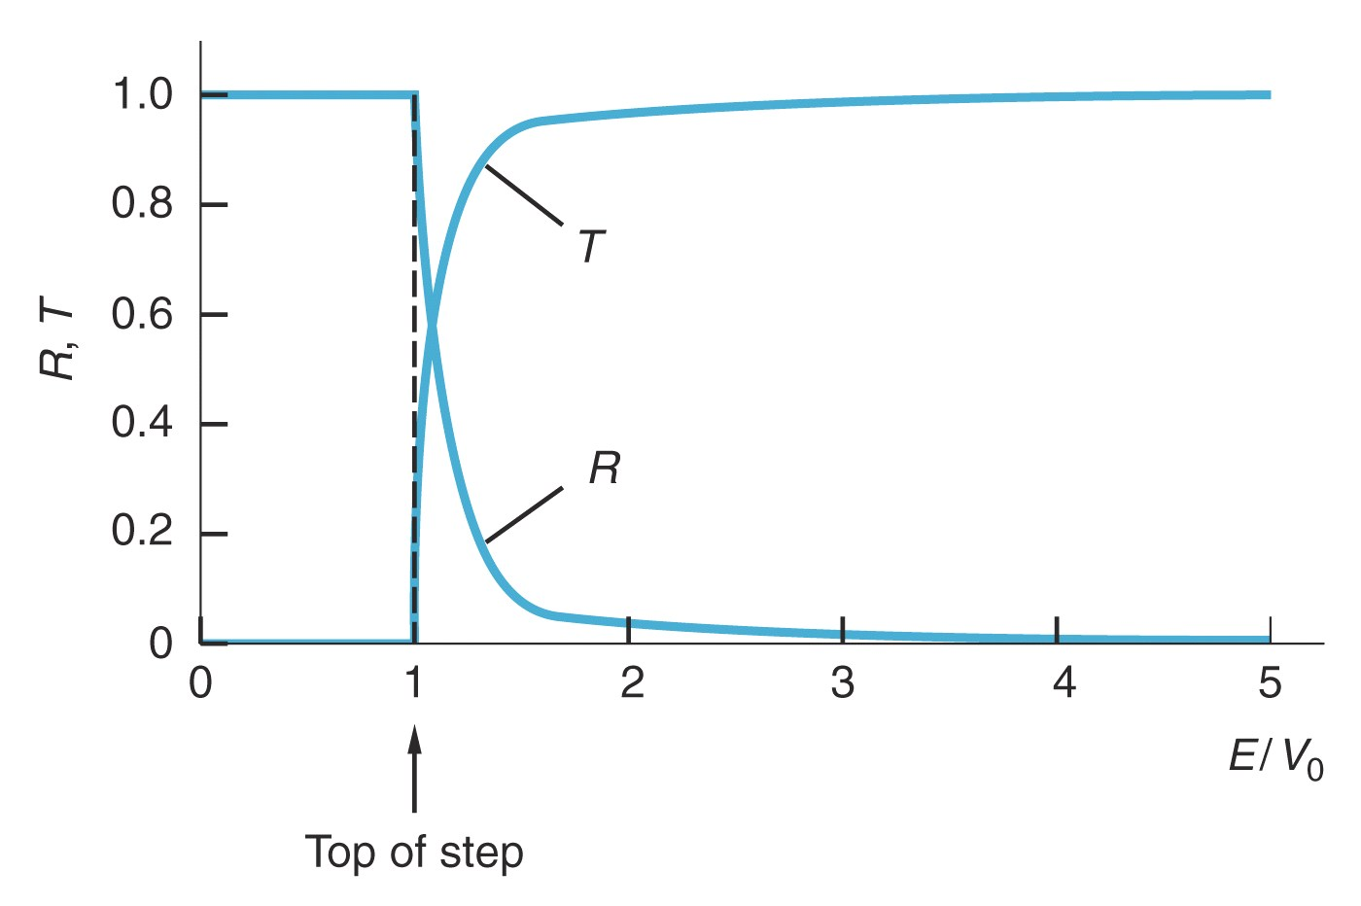
Transmission and reflection of particles for different energy

Slide 39
Barrier Potential (Tunneling Effect)

Slide 40
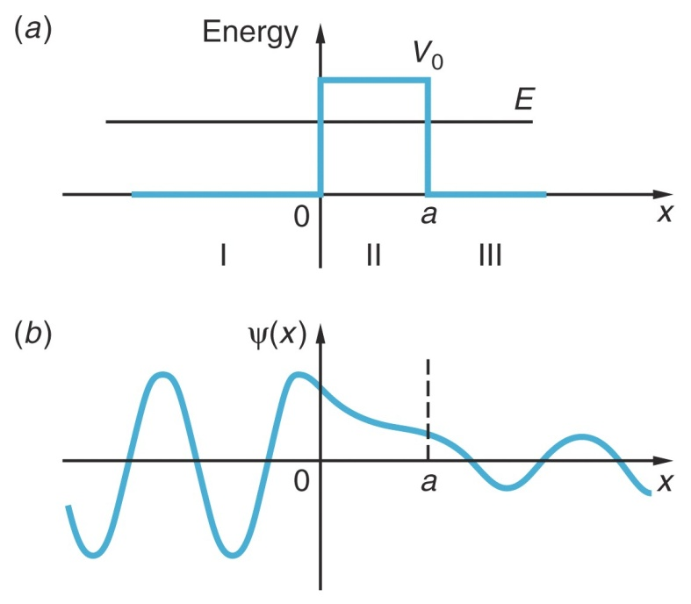
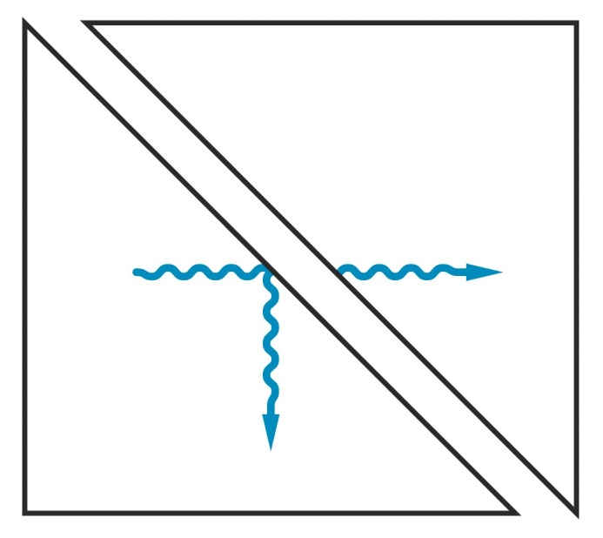

Slide 41
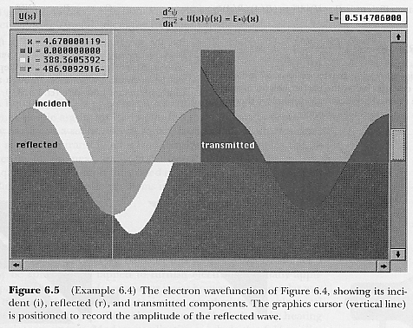
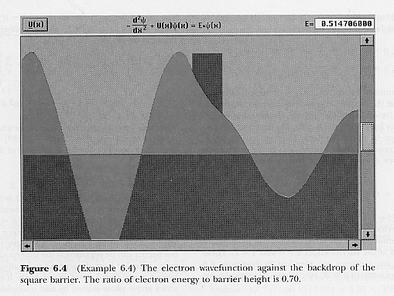
Incident
Reflected
Transmitted
Total wave function

Slide 42
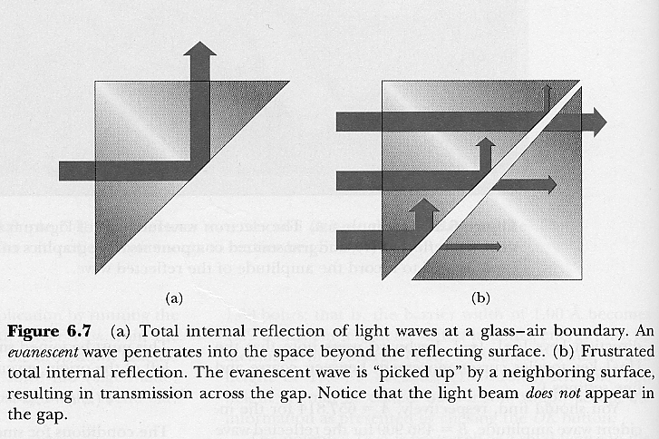
Total Internal Reflection

Slide 43
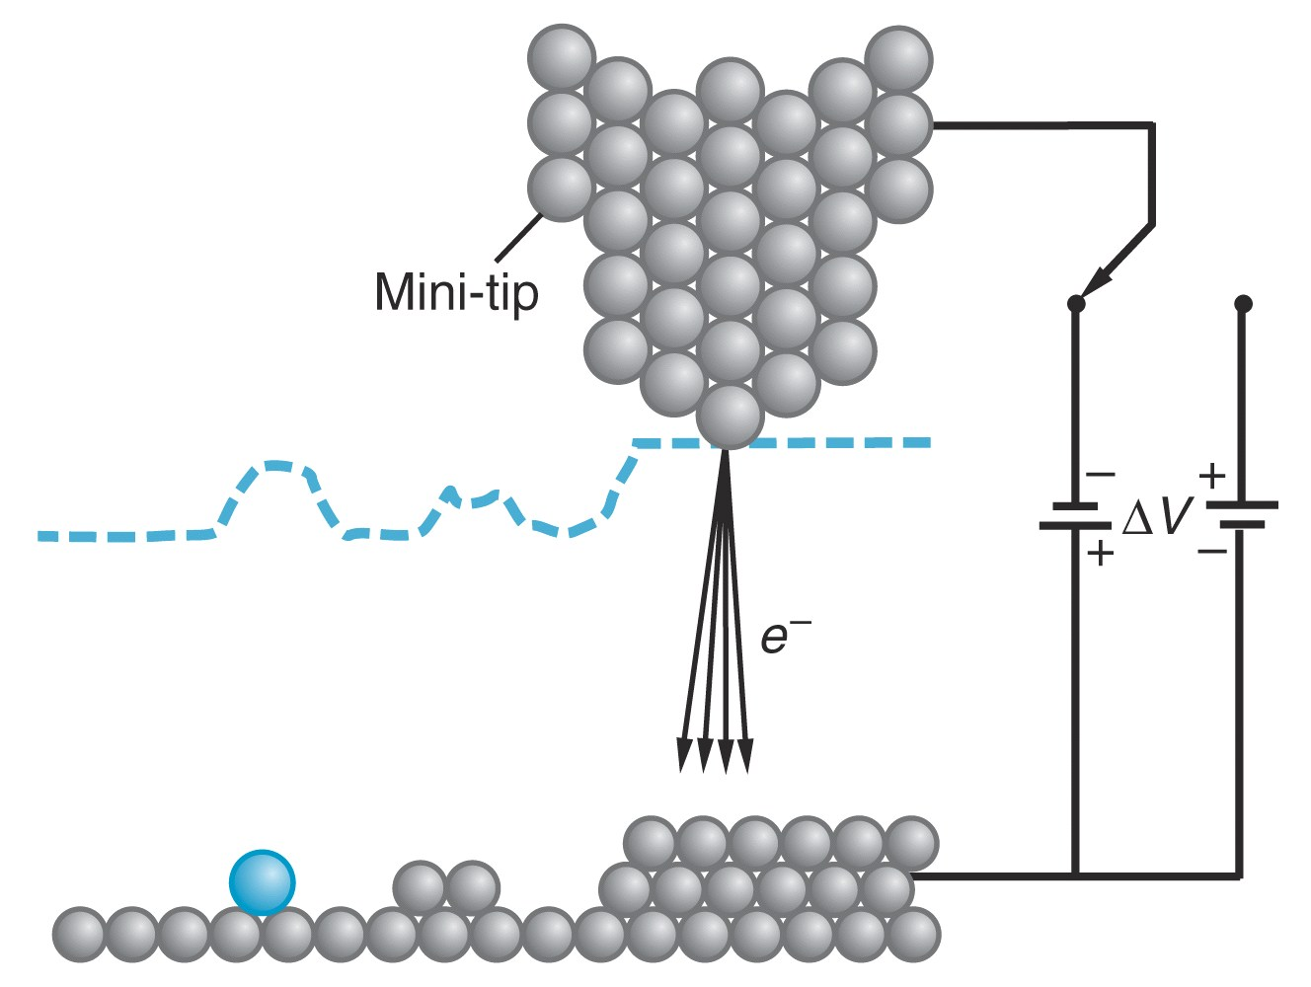
Scanning Tunneling Microscopy

Slide 44
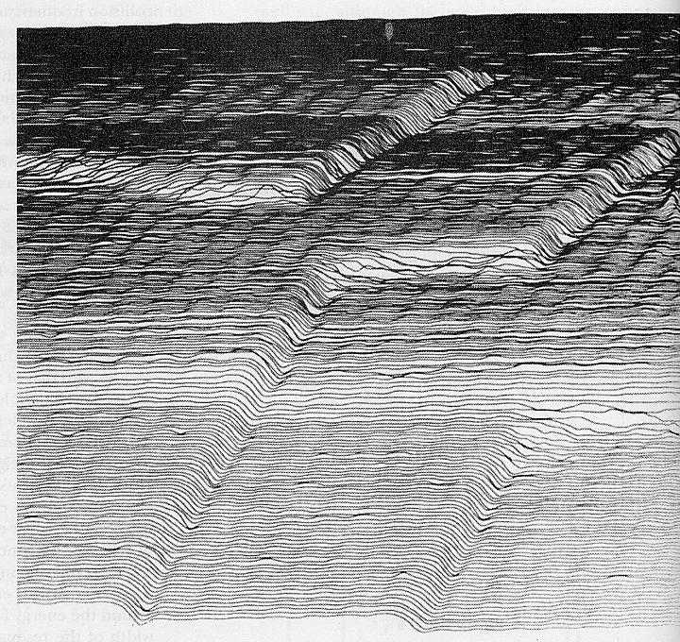
STM Operation
Image construction

Slide 45
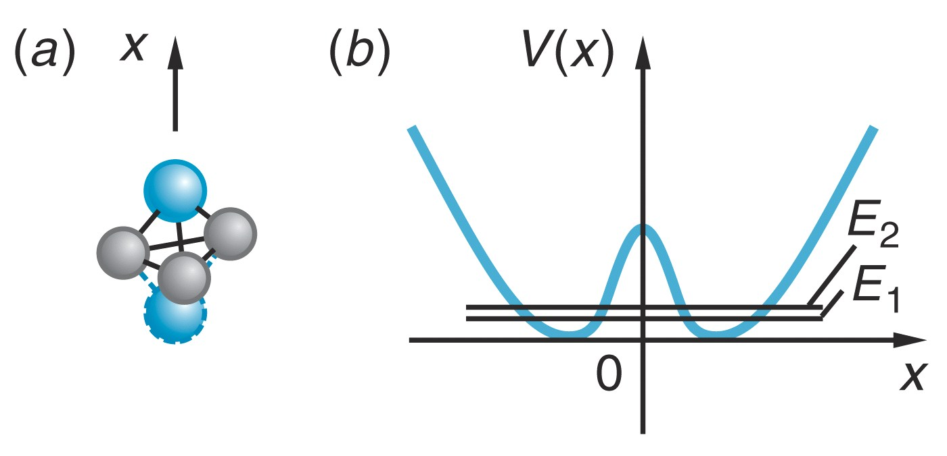
NH₃ Atomic Clock

Slide 46
The Simple Harmonic Oscillator

Slide 49
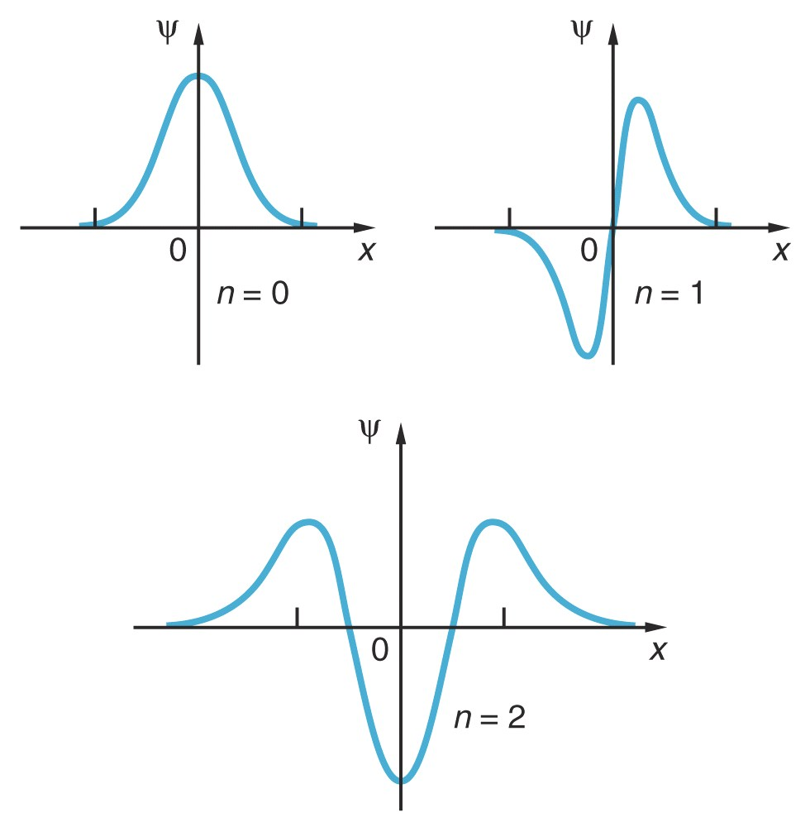
Wave Functions of the Simple Harmonic Oscillator

Slide 50
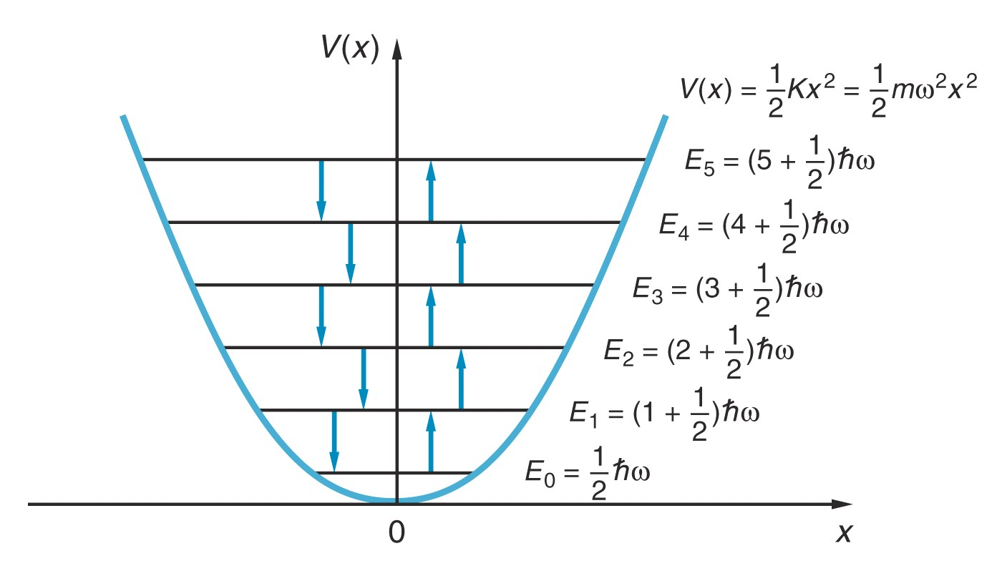
The Transition Selection Rule

