Slide 1
The Wavelike Properties of Particles
Wei-Li Chen
11/29/2013

Slide 2
What is Wave?
Classical wave is a self-sustaining disturbance of a media, which moves through space transporting energy and momentum. According to the directions of the media displacement and wave propagation, a traveling wave can be longitudinal or transverse.
Optical light is an electromagnetic wave.
If we check the waveform after an increase in time Δt, the corresponding increase in x is vΔt, therefore
➔The profile of the wave does not change
new x new t

Slide 3
f(x)
t = 0
0
x
t = t’
f(x’)
f(x)=f(x’-vt’)
0 0
x’
x
vt’

Slide 4
Longitudinal wave Transverse wave

Slide 6
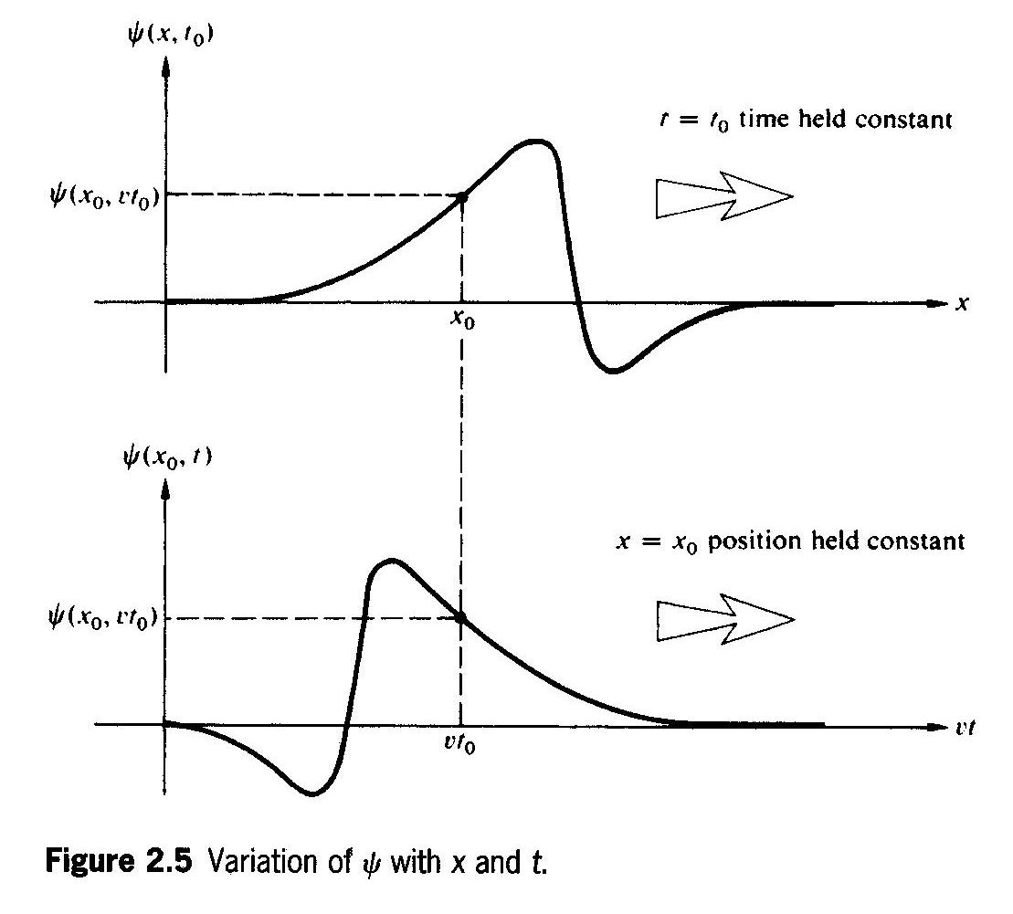
Variation of Ψ with x and t
Photo taking
Frozen time
Staring at focus
Time flies

Slide 7
The de Broglie Hypothesis

Slide 8
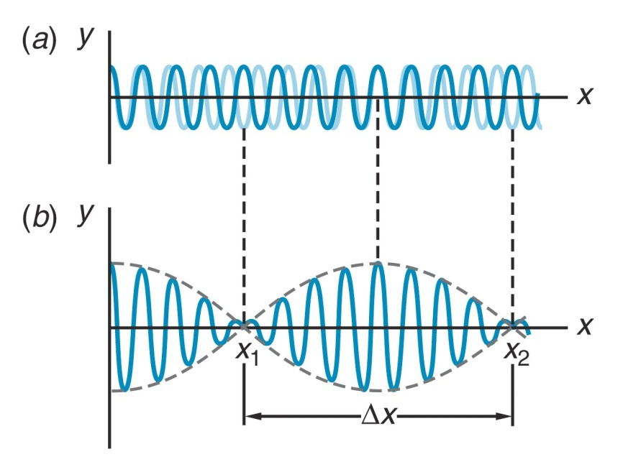

Slide 9
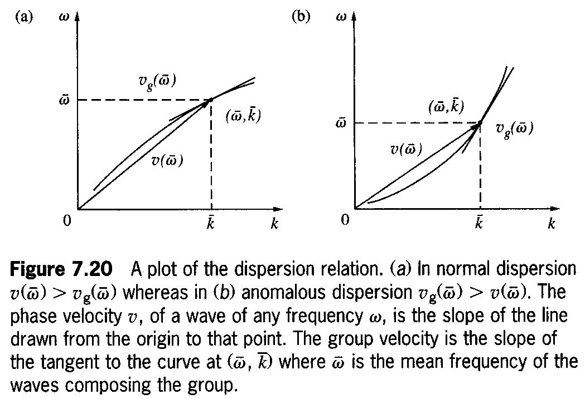
Normal dispersion
Anomalous dispersion

Slide 10
Fourier Series

Slide 11
Fourier Analysis of a Square Wave

Slide 12
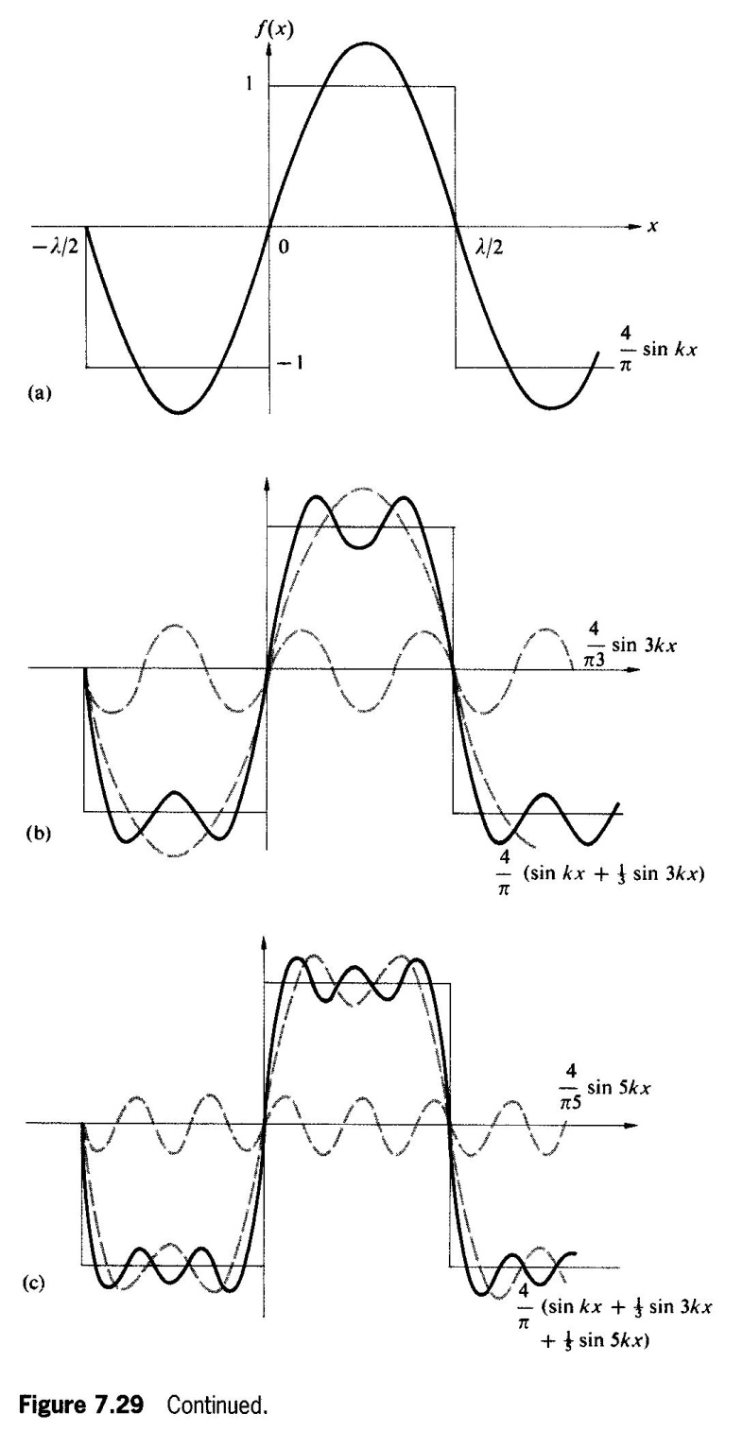

Slide 14
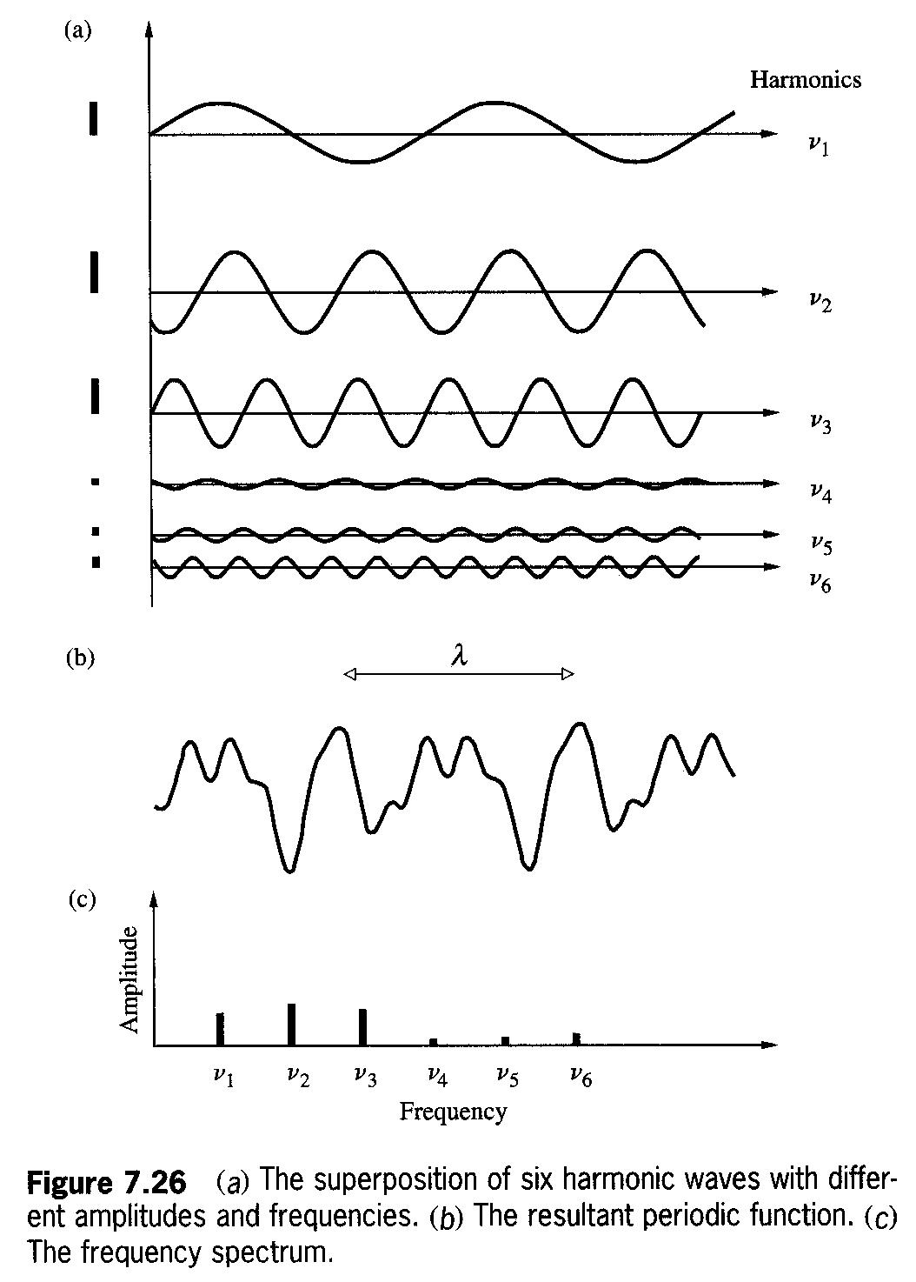
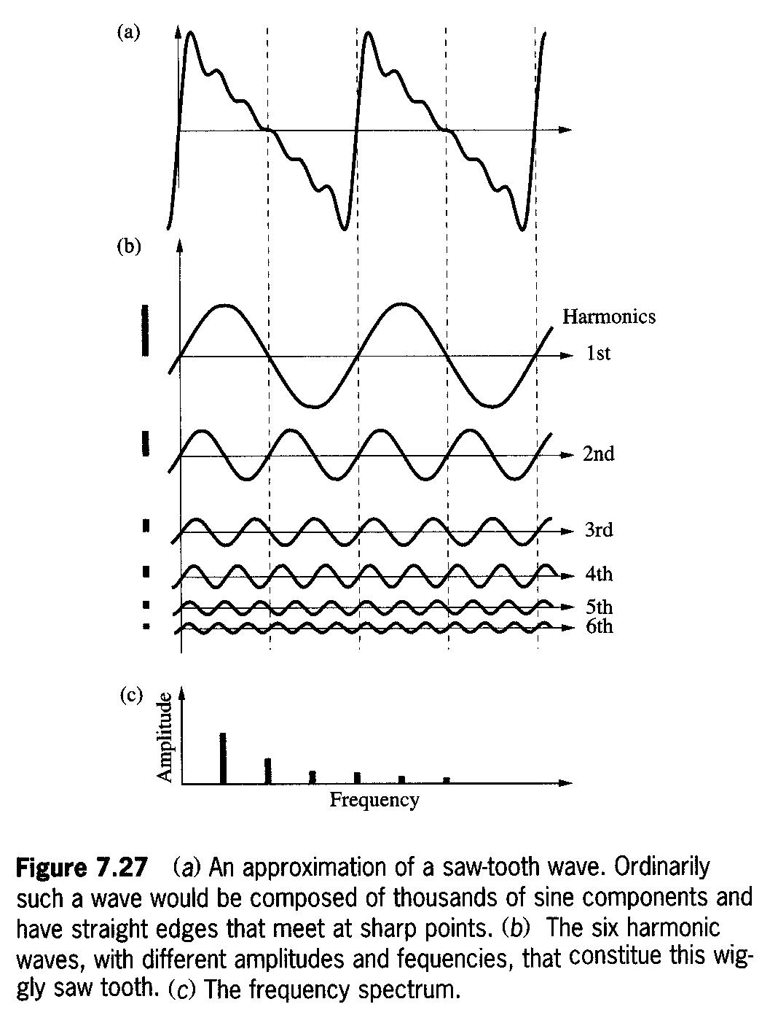
Frequency Spectra

Slide 15
Fourier Integral

Slide 16
Fourier Integral

Slide 17
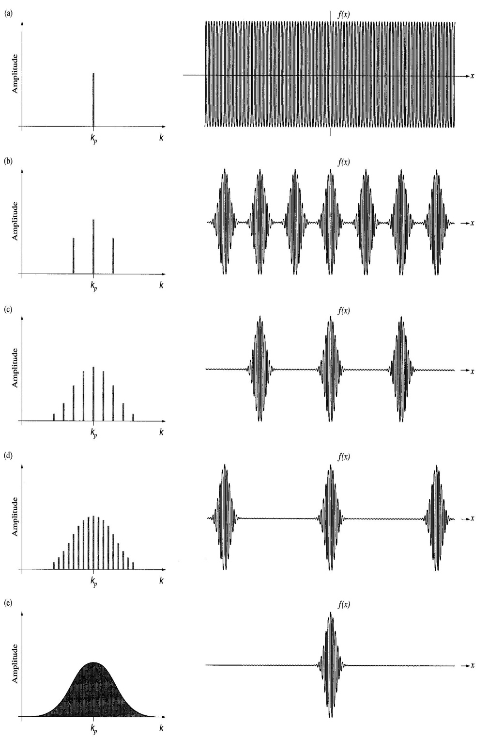
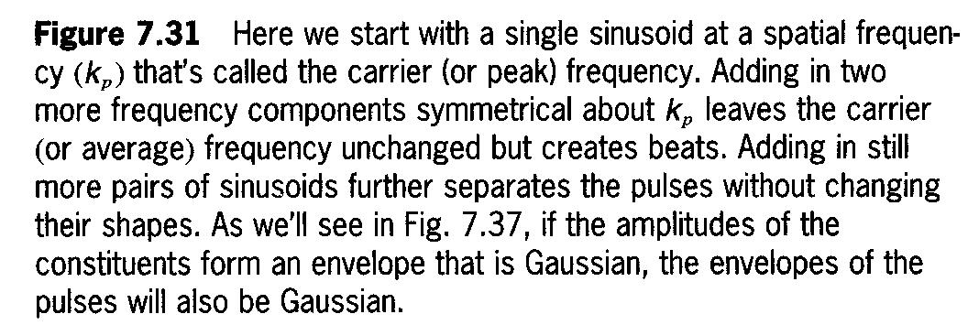

Slide 19
v is the velocity of the electron particle
The group velocity of the particle wave is the same as the velocity of the electron particle

Slide 20
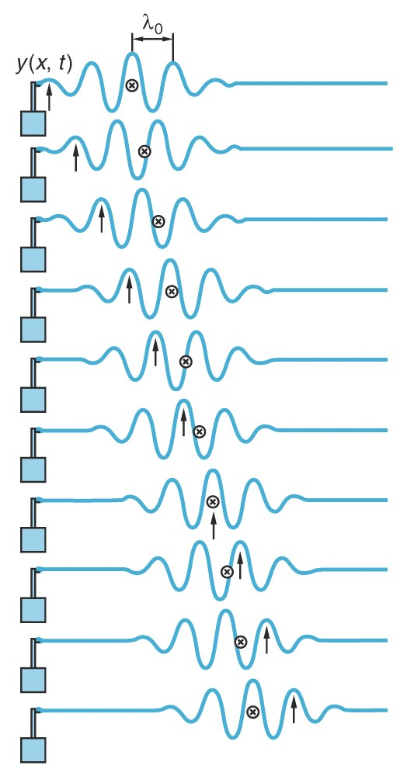
Phase Velocity and Group Velocity
In this case,
V_{p}>V_{g}

Slide 21
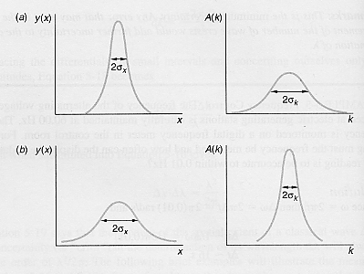
Fourier Integral

Slide 22
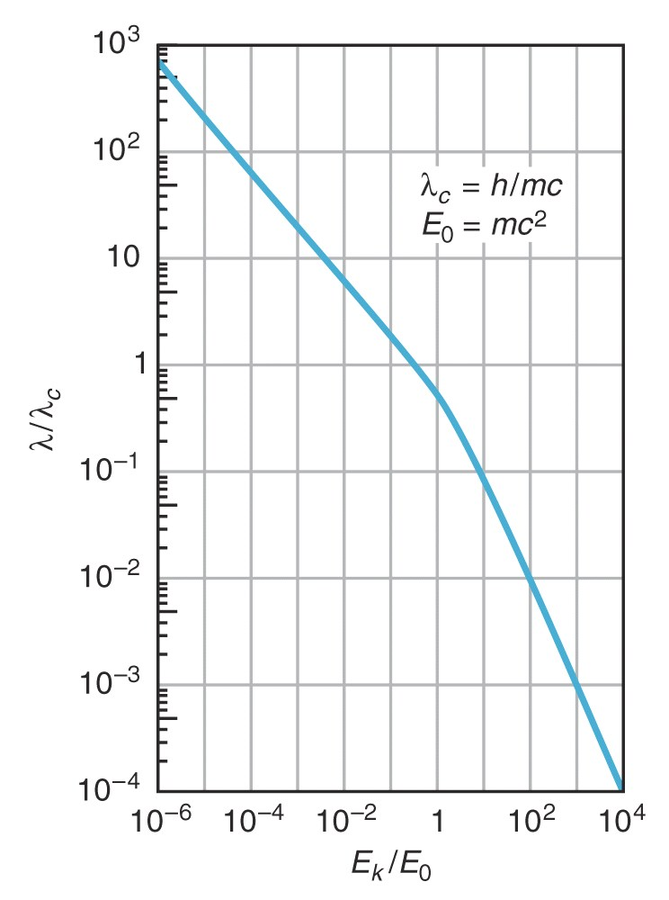
Relativity correction

Slide 23
The Davission-Germer Experiment

Slide 24
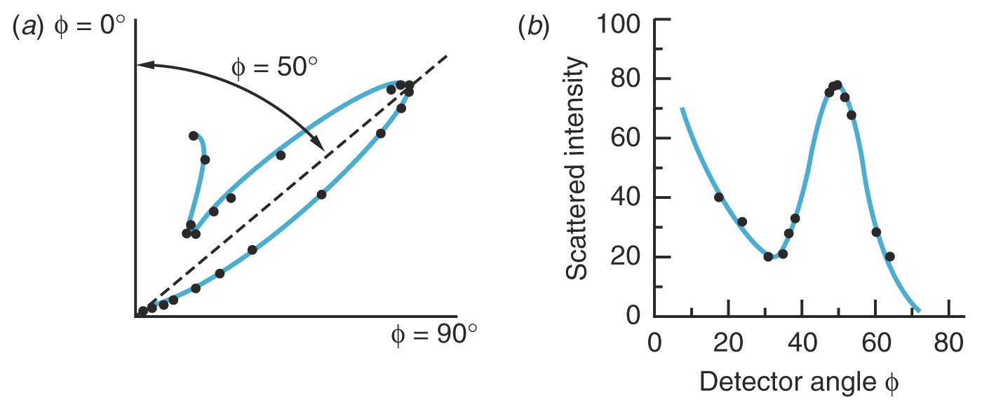
Polar Plot of Scattering Amplitude

Slide 25
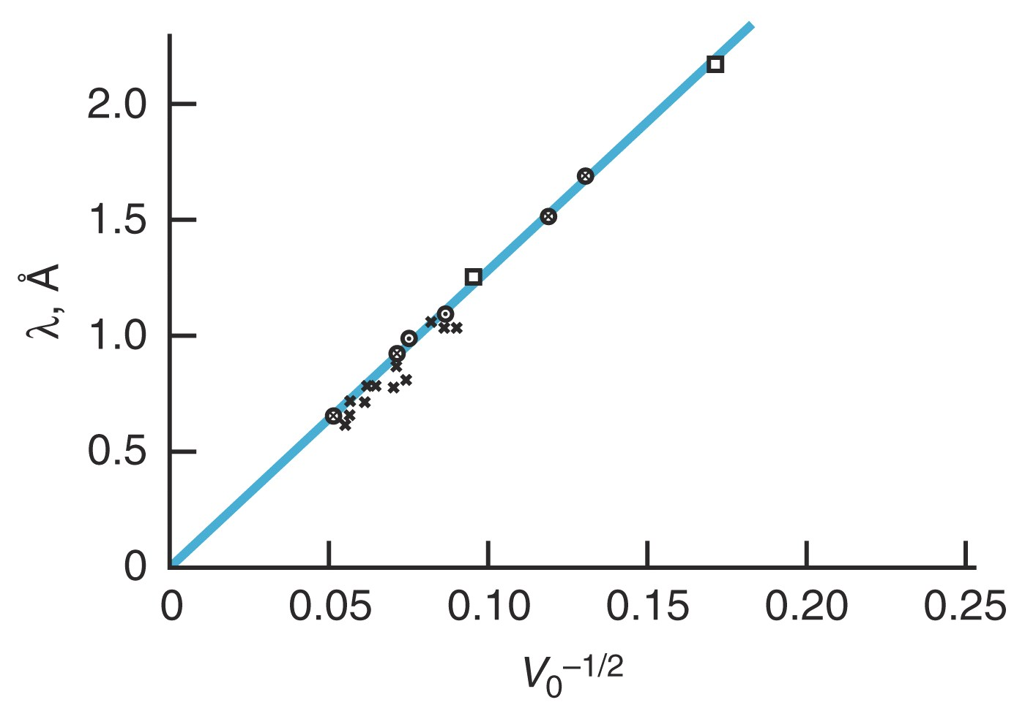

Slide 26
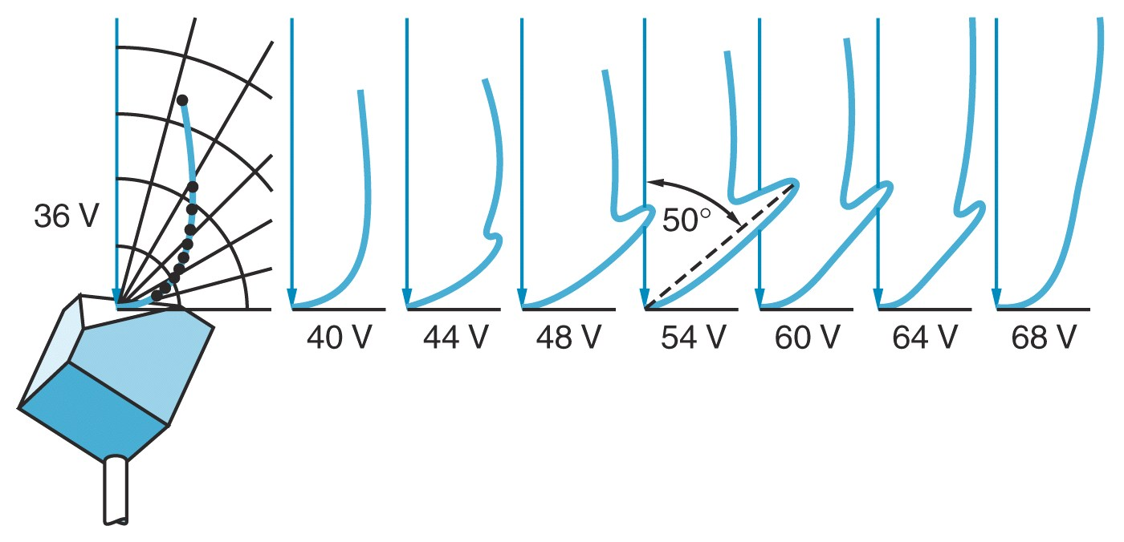

Slide 27
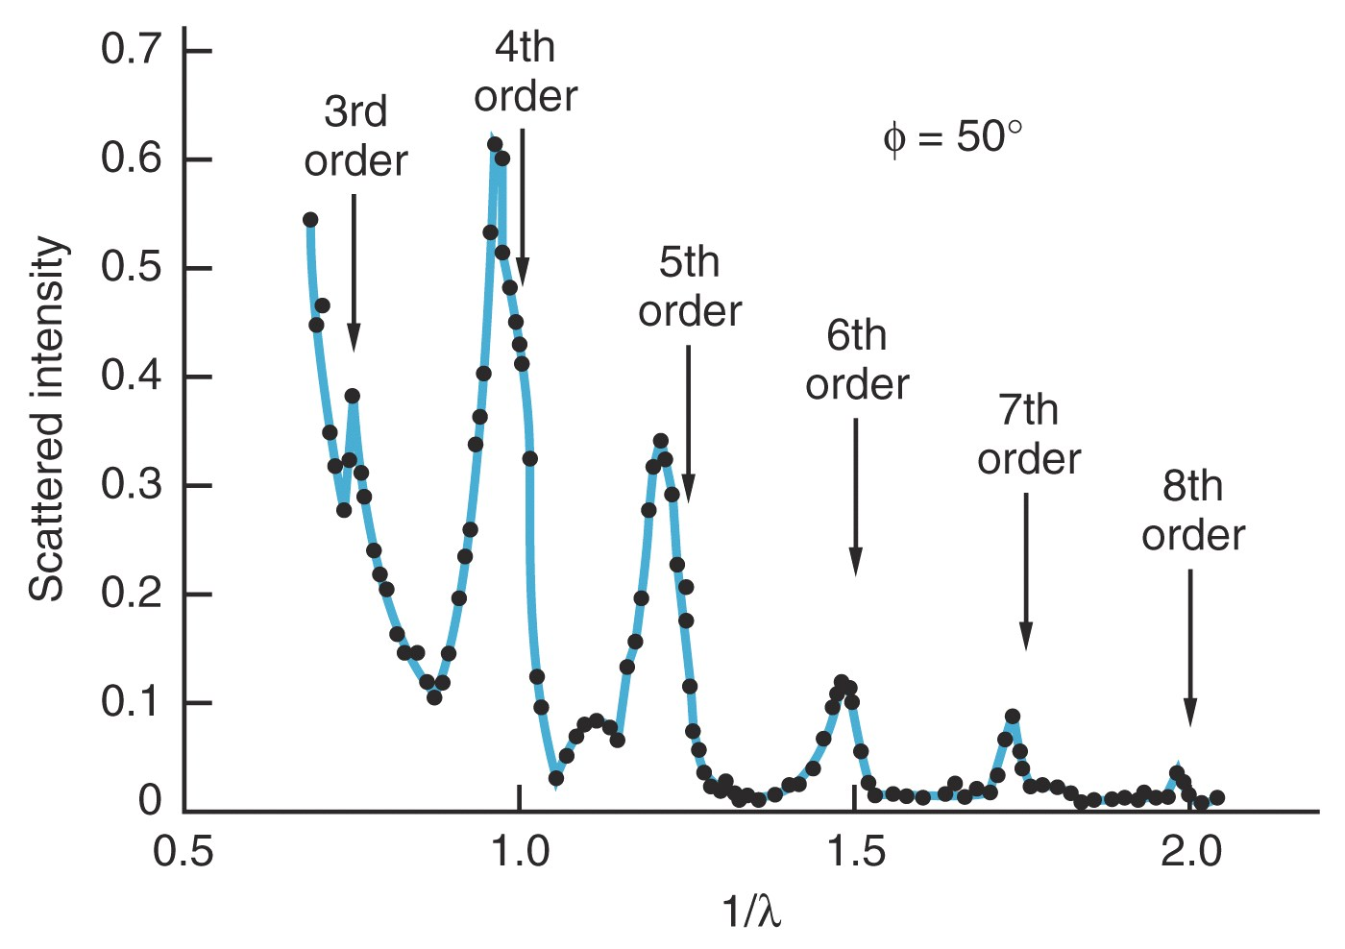

Slide 28
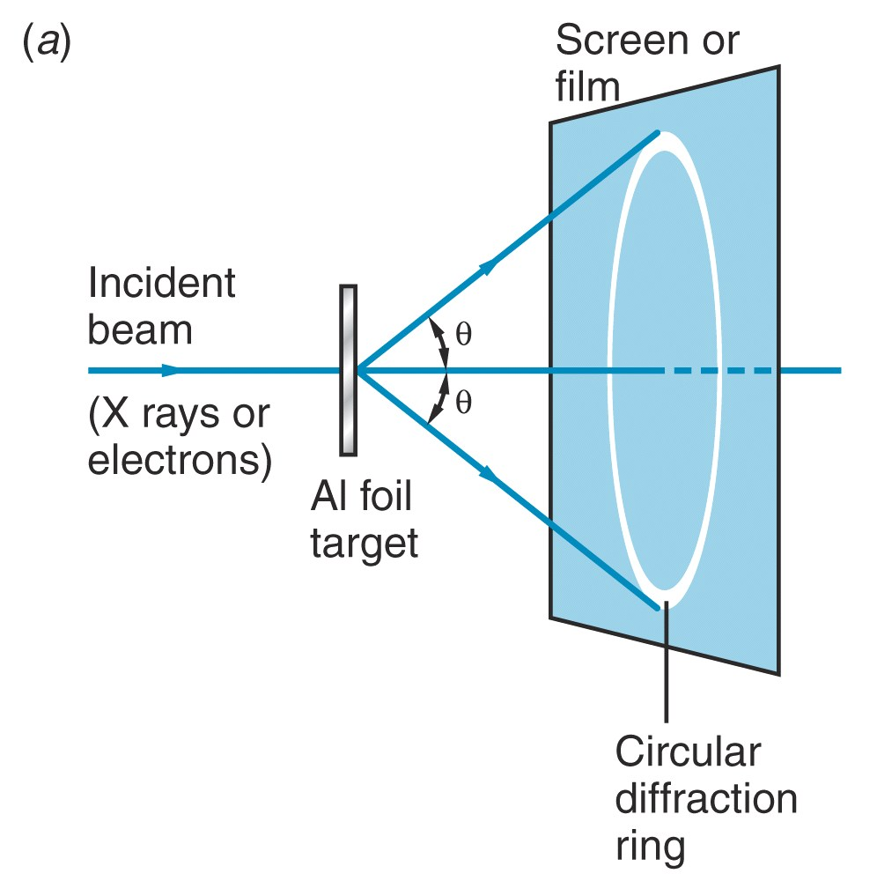

Slide 29
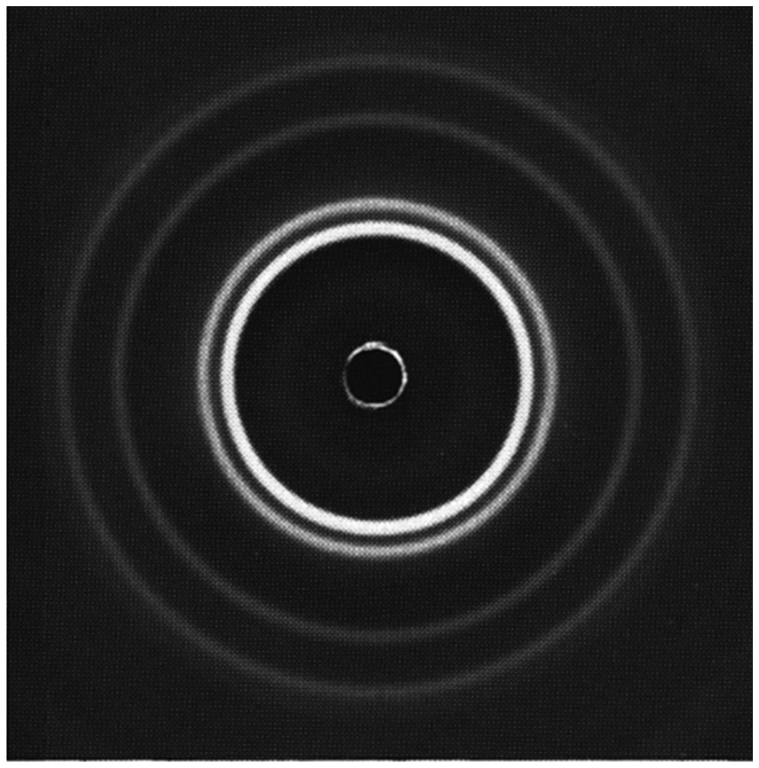
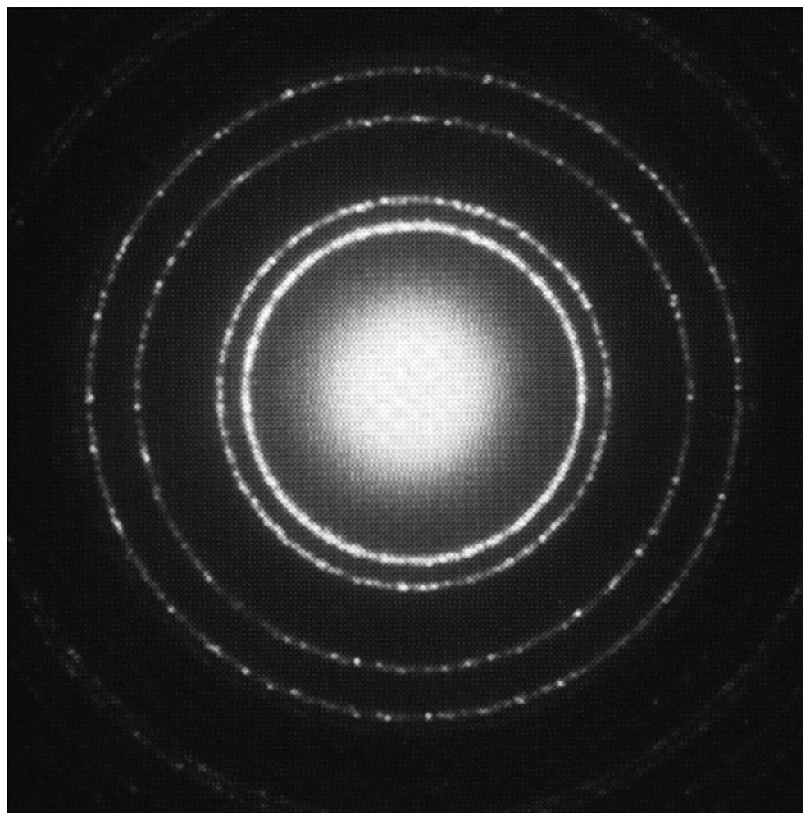
X-ray diffraction Electron diffraction

Slide 30
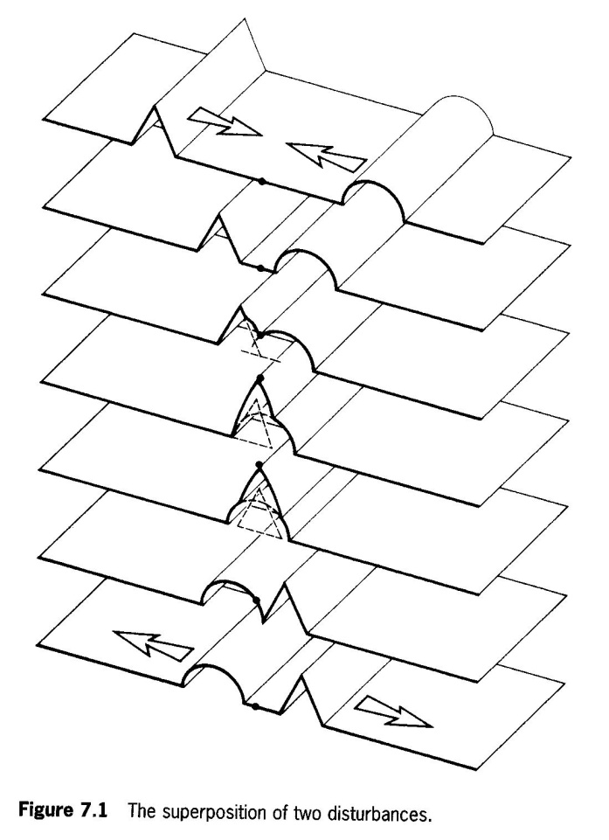
Principle of Superposition

Slide 31
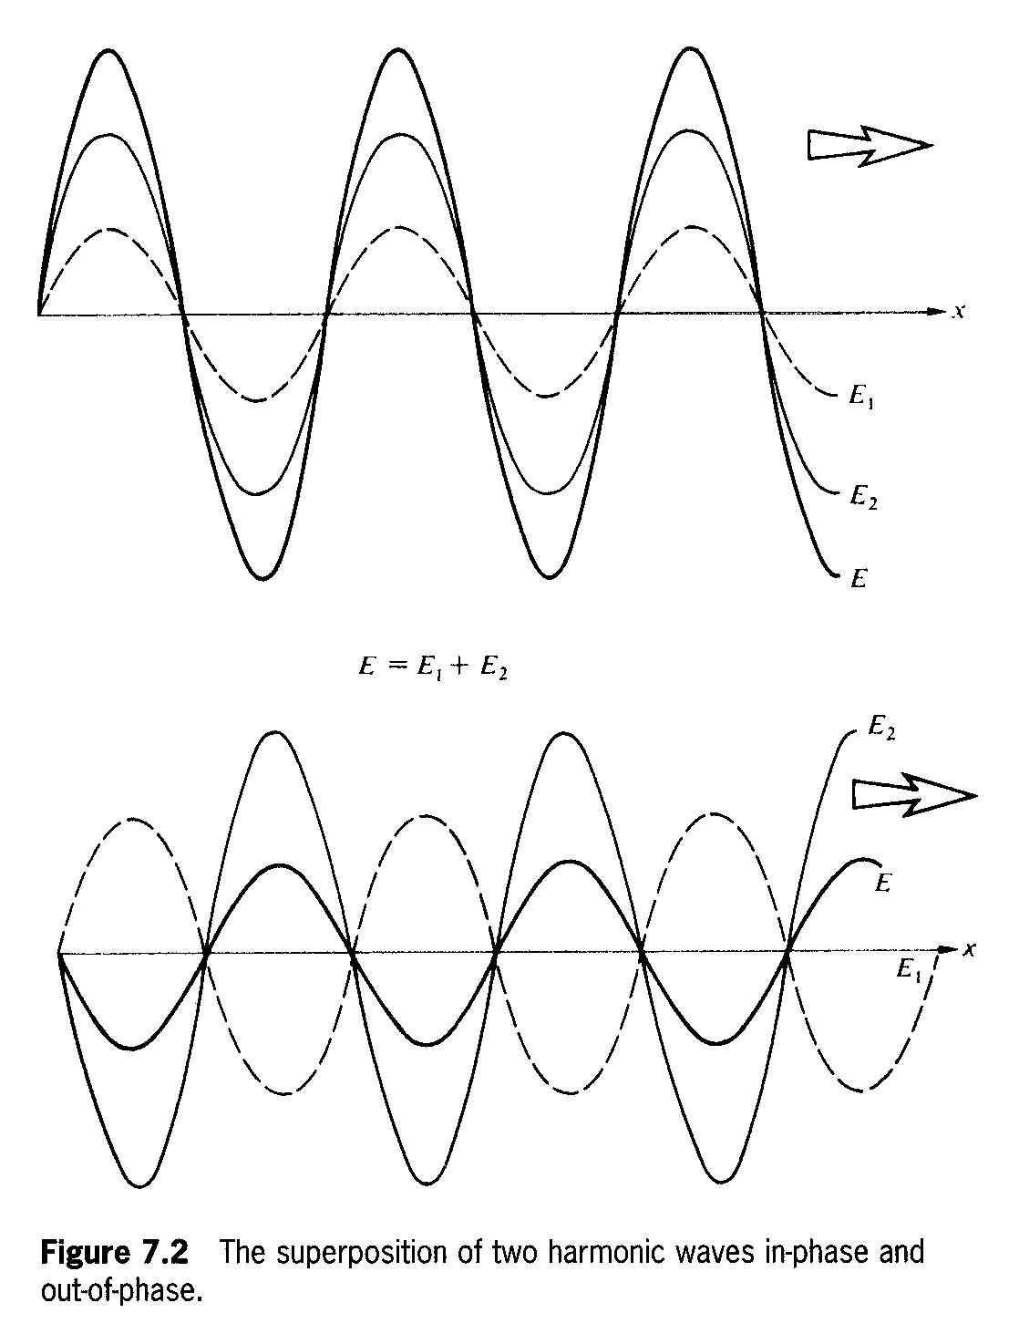
The Addition of Waves of the Same Frequency

Slide 32
interference term
(coherence)

Slide 33
Superposition of Many Waves

Slide 34
Phasor Addition
superposion of two waves at the same location

Slide 35
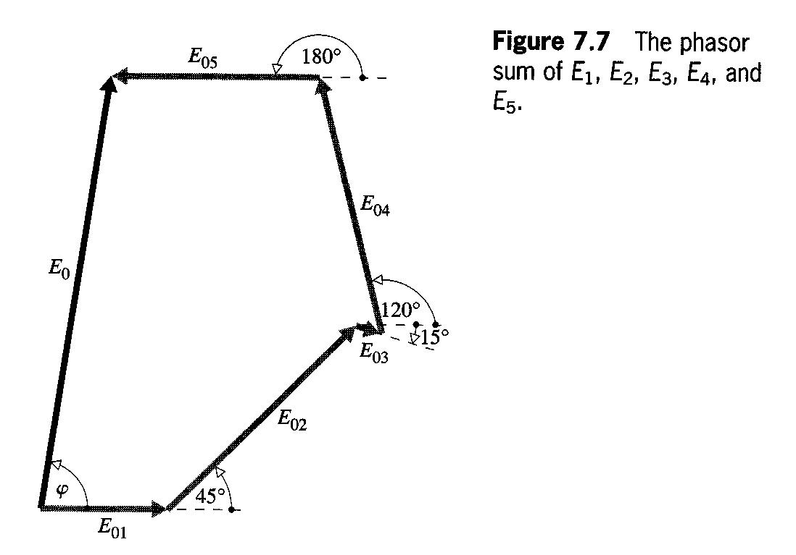
The adding of phasors are identical to the adding of vectors

Slide 36
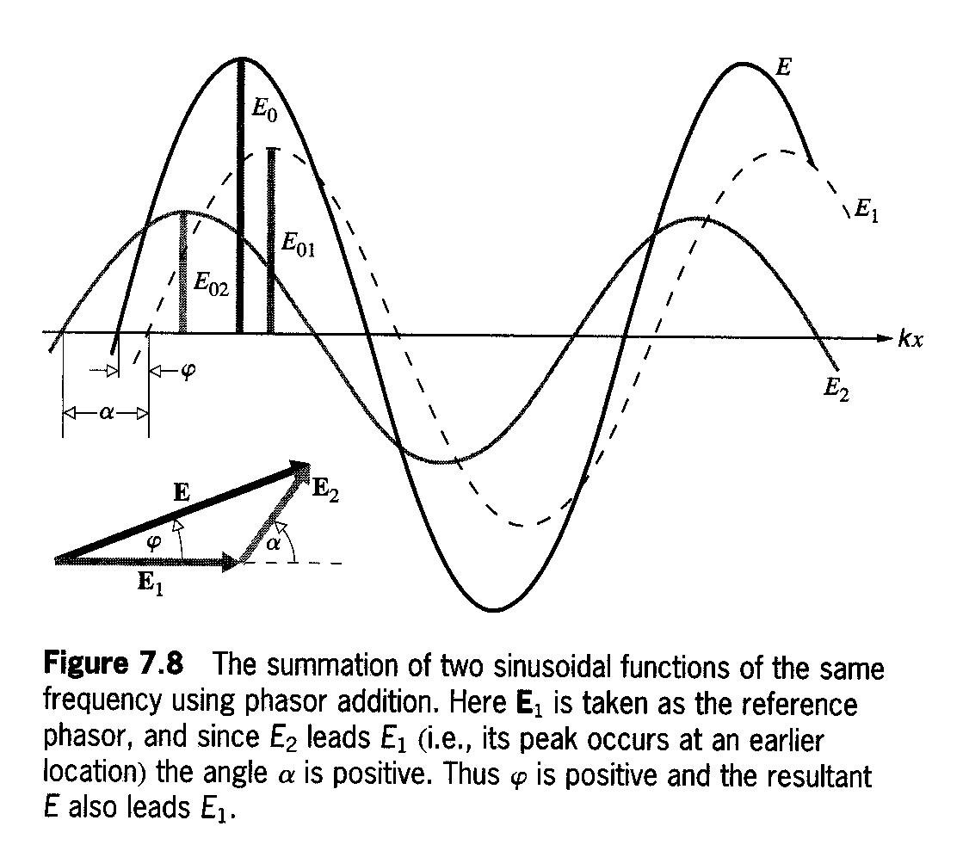
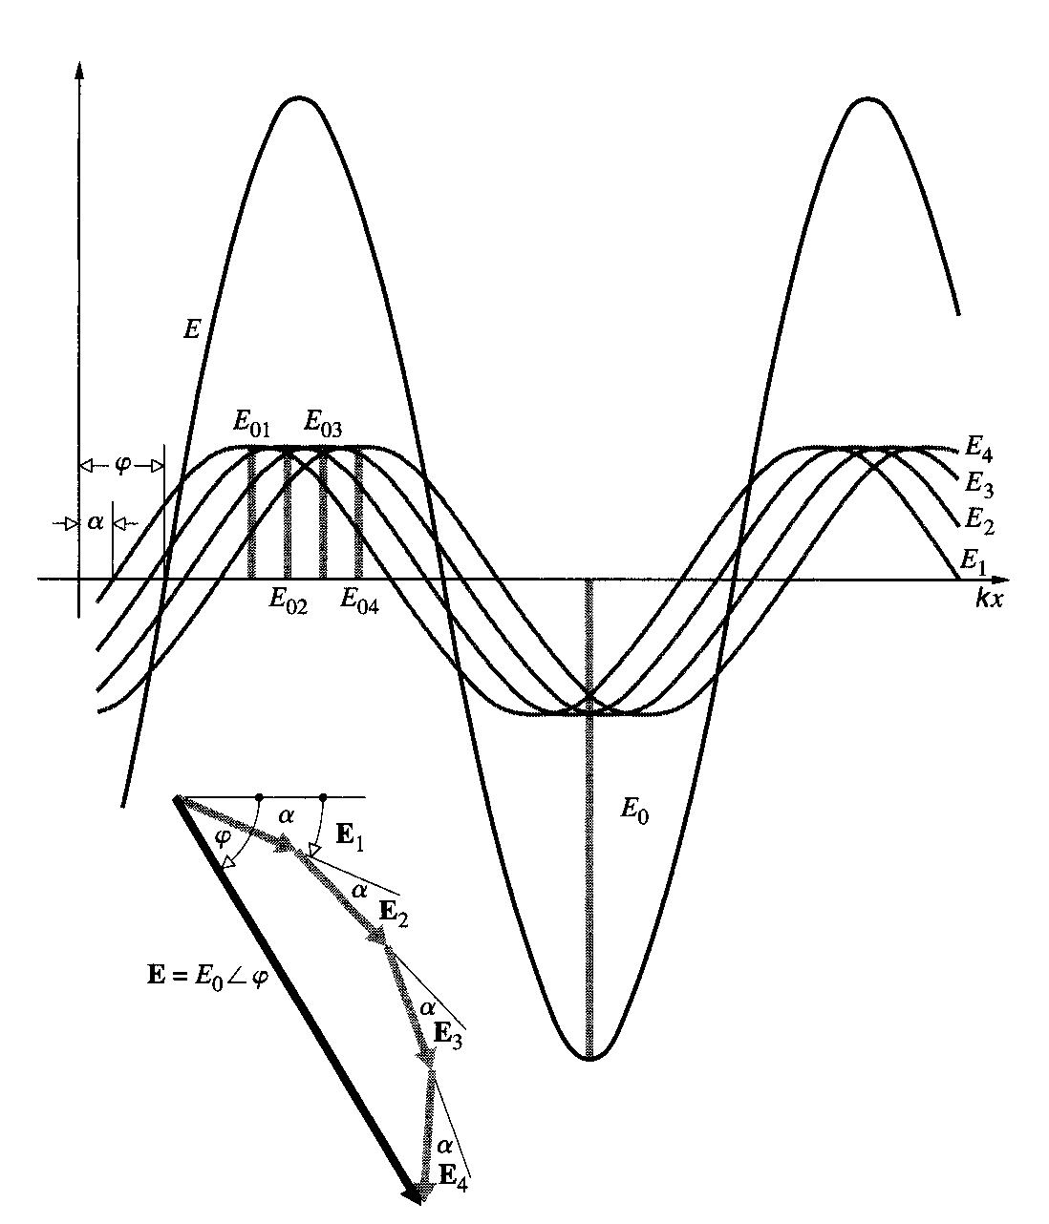

Slide 37
Double Slit Experiment
Where will one particular electron go?

Slide 38
The number of photons in a unit volume is proportional to E².
Reduce the intensity of light to observe photons one by one.
No photons at destructive interference points.
The statistical number distribution of photons is the same as the one calculated by interference formula.
Same experiment can be performed by electrons.
Ψ (complex) is the particle wave description of the electron. The quantity |Ψ|²=Ψ*Ψ (real) is proportional to the probability of detecting an electron in a unit volume.
In one dimension, |Ψ|²dx is the probability of an electron being in the interval dx.
P(x)dx = |Ψ|²dx
where P(x) is the probability distribution function.

Slide 40
Which Slit Does the Electron Go Through?

Slide 43
The Uncertainty Principle
Heisenberg’s uncertainty principle:
The position and momentum of a particle can not be simultaneously measured with unlimited accuracy
In classical mechanics, the equations of motion of a system with given forces can be solved to give us the position and momentum of a particle at all values of the time, as long as the initial (t=0) precision position and momentum of the particle are known.
Measurement of position or momentum affect the system in limited or controllable level in classical physics. It is similar to the case that when v/c is small, relativity is not important.
The minimum energy of a photon is hv, and its momentum is hc/v. It is the Planck’s constant h that makes the initial condition can not be measured accurately.

Slide 44
Bohr’s microscope
thought experiment

Slide 45
Consequences of the Uncertainty Principle
If we try experimentally to determined whether radiation is a wave or a particle, we find that an experiment which forces radiation to reveal its wave character strongly suppresses its particle character.
Wave-particle duality is complementary, not contradictory.
Examples: Bohr’s microscope & electron in a well.
uncertainty ➔ prediction ➔ probability
The future can not be predicted precisely because the present state is not known exactly (according to the Uncertainty Principle). But the statistic behavior can be predicted by using wave function.

Slide 46
The Uncertainty Principle
To use time, space, and deterministic relationship to precisely describe the fundamental processes in an atom is impossible.
The experimental result of a single atomic particle can not be anticipated. Only the probability of all possible results can be predicted.
If the same experiment is repeated on identical systems for many times, the statistic results can be precisely predicted.

Slide 47
海森堡引申說：“自然科學並非簡單地描述和解釋大自然﹔它是大自然和我們自身相互作用的一部分。”“我們所觀察到的並非大自然本身，而是我們的探究方法所揭示的大自然。”這是在闡明觀察方法會對觀察結果產生影響，即我們所獲得的觀察結果與採用的觀察方法有關，這並不是在否定觀察結果的客觀性。不同的觀察者採用相同的觀察方法，仍然應該得到相同的結果，而不是各不相同。

Slide 48
Wave-Particle Duality
All phenomena (electrons, atoms, light, sound) have both particle and wave characteristics.
The observations of matter and radiation are described in terms of the particle aspects.
The prediction about what may be observed are described in terms of the wave aspects.

Slide 49
Minimum Energy of a Particle in a Box

Slide 50
Size of the Hydrogen Atom

Slide 51
Widths of Spectral Lines

