Slide 1
Crystal and X-ray Diffraction
Part I
Wei-Li Chen
2014/01/20
Department of Electronic Engineering
National Changhua University of Education

Slide 2
Crystal Structure
Crystal = Lattice + Basis
Lattice: an infinite periodic array of geometric points in space. 14 distinct lattices.
Basis: identical group of atoms
Unit cell: the most convenient small cell in a crystal structure that carries the characteristics of the crystal. The repetition of the unit cell in three dimensions generates the whole crystal structure.
Primitive unit cell: the smallest unit cell (not necessarily unique)

Slide 4
7 Crystal Systems (unit cell geometry) and 14 Bravais Lattices
A point represent a basis

Slide 5
Face Center Cubic

Slide 6
Body Center Cubic (BCC)

Slide 7
Hexagonal Close-Packed

Slide 8
Diamond and Zinc Blende Unit Cell (FCC)

Slide 9
Rock Salt Crystal (FCC)

Slide 10
Lattice Parameters, Directions, and Planes in Crystal
Lattice parameters α,β,γ, a, b, and c represent the geometry of the unit cell
[u v w] direction in crystals
<u v w> family of directions
(h k l) Miller indices of a plane
{h k l} family of planes

Slide 12
Intercept x₀, y₀, z₀ are 1/2a, 1b, ∞c
Intercept x, y, z in terms of a, b, c are ½, 1, ∞
Reciprocals 1/_{1/2}, 1/1, 1/ ∞ = 2, 1, 0
The Miller indices are (2 1 0)
If the interception is in the negative direction, the Miller indices are
. .
(2 1 0)
For cubic crystal, interplanar distance
For tetragonal (hexagonal) crystal, interplanar distance

Slide 13
Planes of a Zone
Planes of a zone are planes which are all parallel to one line. The line is called zone axis, and the set of planes are called the zone.

Slide 14
X-ray Tube

Slide 15
X-ray Emission Spectrum by Electron Bombardment
Characteristic
emission
Continuous
emission

Slide 16
Continuous Emission
Continuous spectrum emitted by decelerated electrons is called heterochromatic radiation or white radiation (bremsstrahlung radiation)
Short wavelength limit

Slide 17
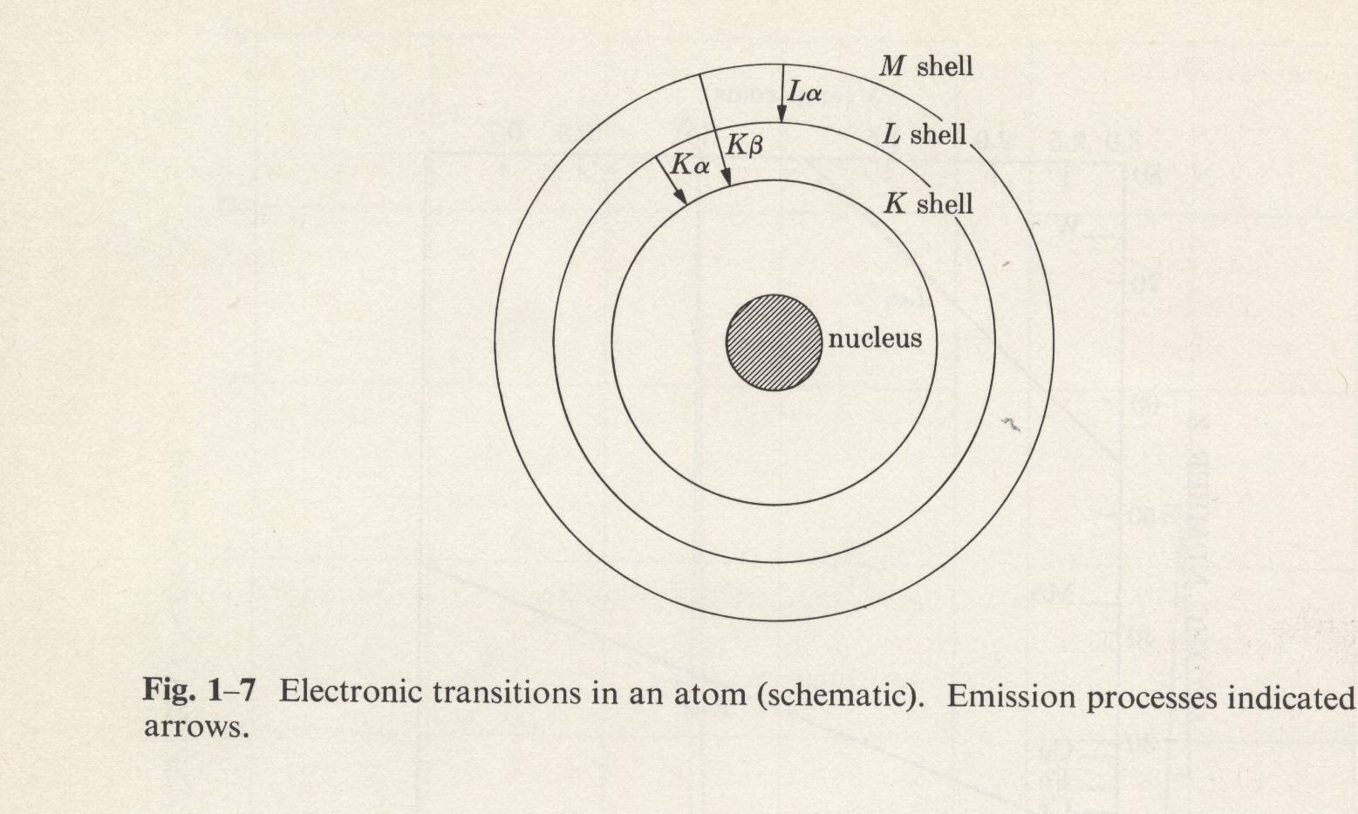
Characteristic Emission
High intensity
Narrow line width
Fixed wavelength
Fall into several groups referred as
K, L, M, N…

Slide 18
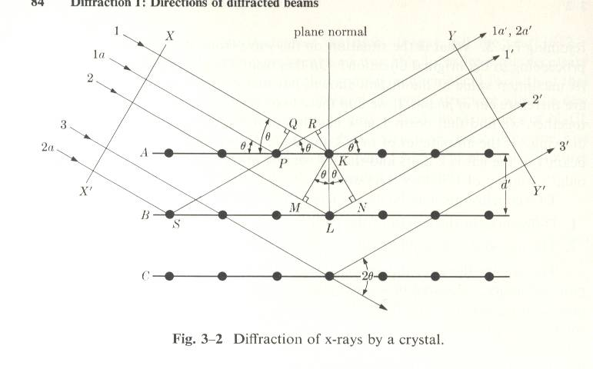
Bragg Diffraction
Consider rays 1’ and 1a’ from the same plane
QK – PR = PKcosθ – PKcosθ = 0
Consider rays 1’ and 2’ from adjacent planes
ML + LN = d’sinθ + d’sinθ
Constructive interference
2d’sinθ=nλ
is called Bragg condition

Slide 19
Diffraction Methods
 | λ | θ
Laue method | Variable | Fixed
Rotating-crystal method | Fixed | Variable
Powder method | Fixed | Variable

Slide 20
Laue Method
Diffraction spots from zone planes of same zone axis (ZA) located on a curve of ellipse or hyperbola
Detection film can be behind it (transmission) or in front of the crystal (back reflected)

Slide 21
Laue Method

Slide 22
Laue Diffraction Spots (λFixed)

Slide 23
Powder Method
Fine powders of fine crystals oriented in various directions
The powder is equivalent to a single crystal rotated about all possible axes

Slide 24
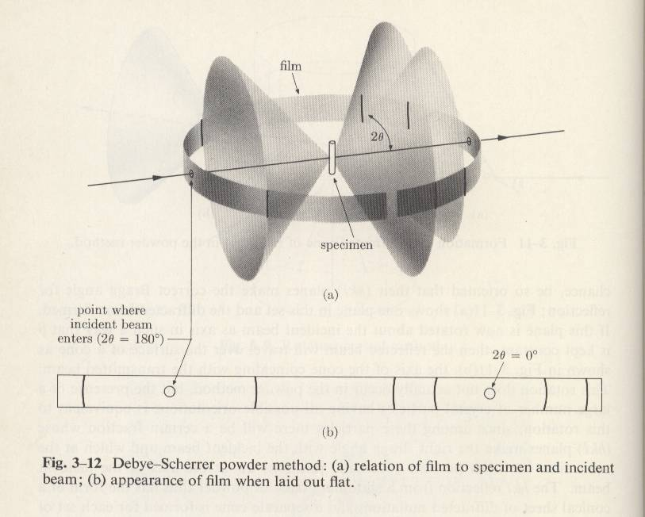
Debye-Scherrer Powder Method

Slide 25
Rotating-Crystal Method
A single crystal is rotating about an axis normal to the incident monochromatic X-ray beam
Planes satisfying Bragg condition form spots on the film mounted on the cylinder wall

Slide 26
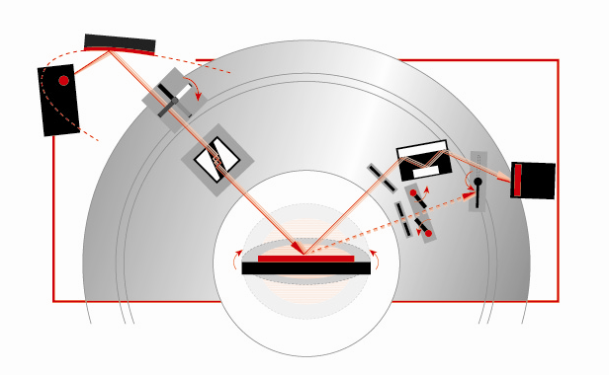
X-ray Rocking Curve Setup
Göbel mirror
Automatic absorber
X-ray tube
Channel-cut analyzer
Sample
Channel-cut monochromator
Detector
Motorized slit

Slide 27
High resolution X-ray diffractometer
Omega (ω), chi (χ), phi (φ) and 2 theata (2θ) rotation axis :
z
Φ scan around y-axis
y
Χ rotation in y-z plane
Ωand 2θ
x

Slide 28
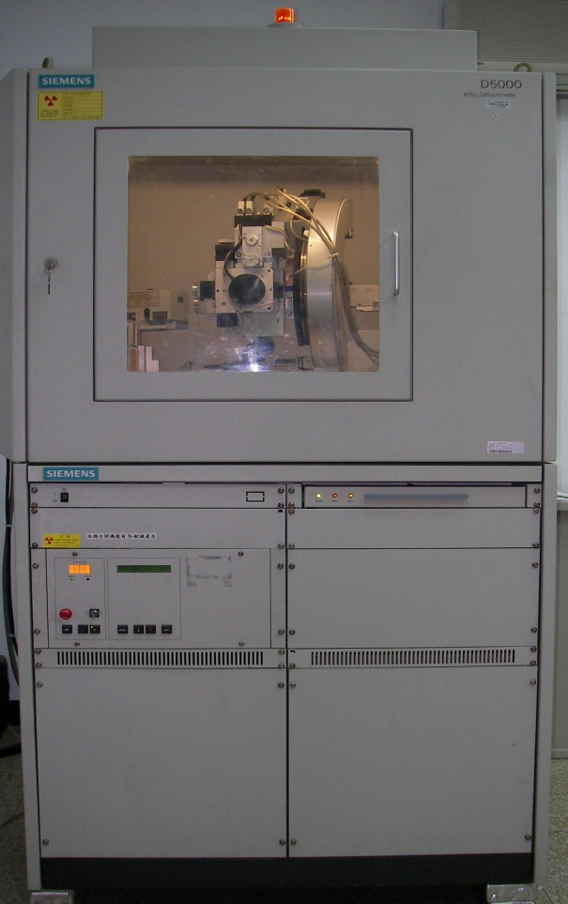
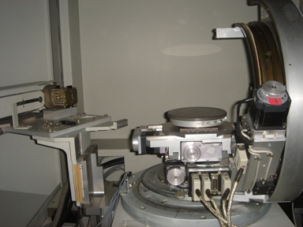
To filter out Kα₂ and keep Kα₁
Gobel mirror
detector
detector
X-ray tube
monochromators
sample
sample
D5000 Discover

Slide 29
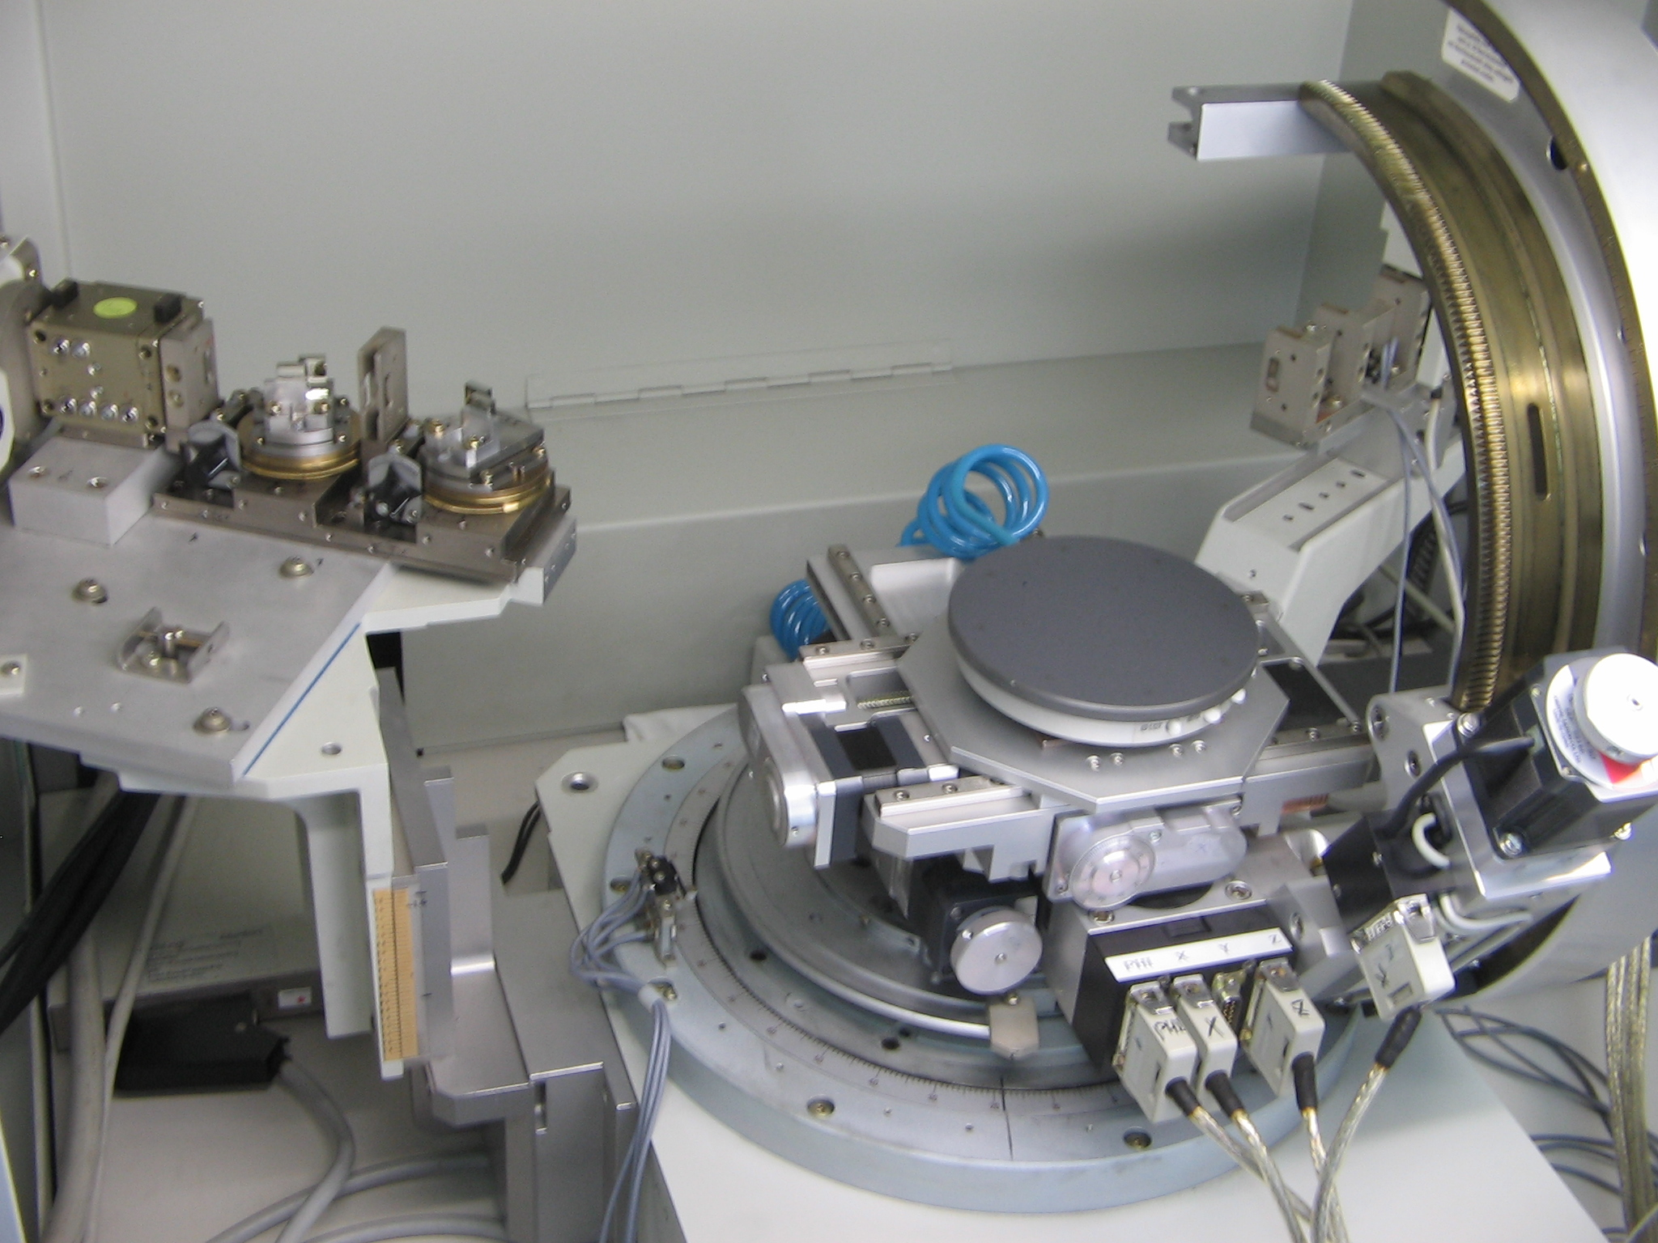
y

